Slide 1
CHARACTERIZATION STUDY OF Load balancer & broker vnfs
Alessandro Giovannini

Slide 2
AGENDA
OVERVIEW OF CASE STUDIES
DATA EXPLORATION/ANALYSIS
3. APPLICATION OF MACHINE LEARNING TECHNIQUES
4. PROCEDURE TO CHARACTERIZE PERFORMANCE OF VNFs
5. CONCLUSIONS
6. STEPS/PLANS for the NEXT SESSION
7. FUTURE WORK

Slide 3

Chapter 1 – OVERVIEW OF CASE STUDIES
SECTIONS :
1.1 – Motivation
1.2 – Introduction to NFV
1.3 – NFV system architecture
1.4 – VNFs description
1.5 – VNFs analyzed

Slide 4
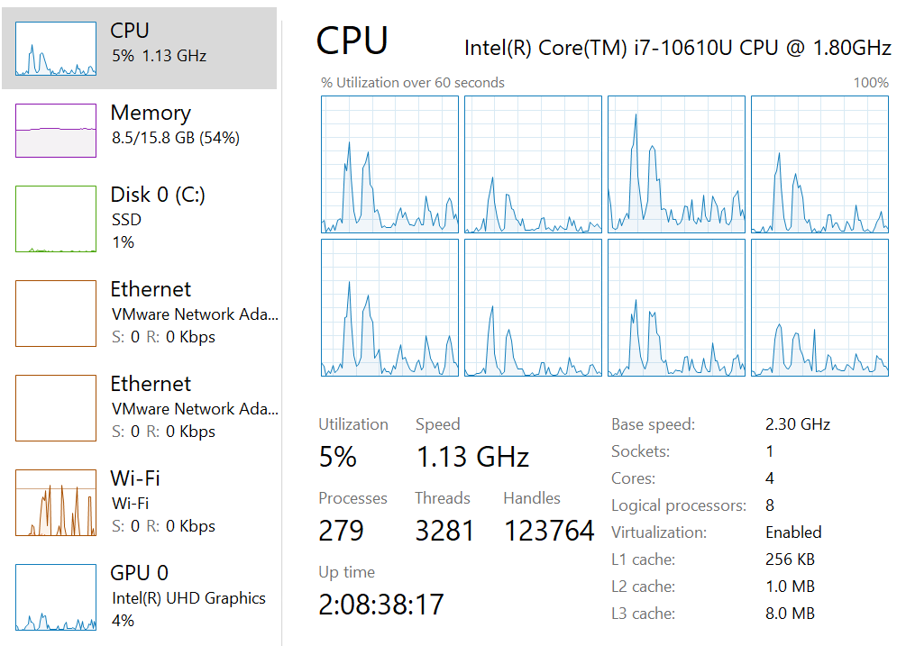
1.1 - motivation
Compute resource consumption has emerged as a very important question today. Knowing, and being able to dynamically optimize resource consumption, for a particular workload, is very important because it not only directly impacts capital and operating expenses but has important impacts on the environment from the perspective of energy consumption and heat dissipation.​ As a consequence, we need to understand when we can scale up (add more resources to easily handle peaks in workload demands) or scale down when resources are no longer needed (that is resource consumption returns to the original state to reduce costs and impacts to the environment).​
The final GOAL of my project was to predict, through the application of machine learning to data, the optimal allocation of the CPU bandwidth within the analyzed systems. Since it is a resource of fundamental importance and allocating it in the right way saves companies money, energy and sustainable impacts to the environment. Final and future studies will focus on RAM, Disk and I/O.

Slide 5
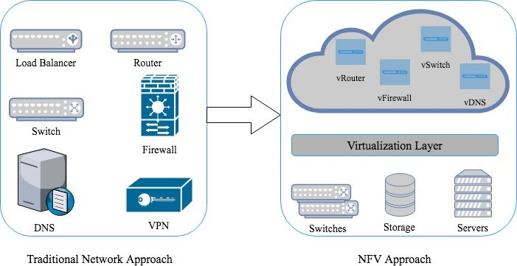
1.2 - introduction to nfv
My studies are based on some components (VNFs) of the Network Functions Virtualization, (NFV) is an approach to telecommunications networking where the network entities that traditionally used dedicated hardware items are now replaced with computers on which software runs to provide the same functionality.
By running a network based around NFV, Network Functions Virtualization techniques, it is easier to expand and modify the network, and it is able to provide considerably more flexibility as well as being able to standardise on much of the hardware as it consists of additional computing power. In this way costs can be considerably reduced.
NFV, is a concept that virtualizes major elements of a network. In this way, rather than having a dedicated item of hardware to provide a given function, software running on a computer / server is used.
Entire classes of network node functions can be set up as building blocks that can be connected to create overall telecommunications networks.
NFV utilises traditional server virtualization, but extends the concept significantly. In this way one or more virtual machines running different software and providing different processes, on top of industry standard high volume servers, are able to provide the functions of switches and storage, or even cloud computing infrastructure, instead of having custom hardware appliances for each network function.
In particular I spent my time analyzing a specific component of NFV namely VNF that is a logical outcome of Network Functions Virtualization (NFV).

Slide 6
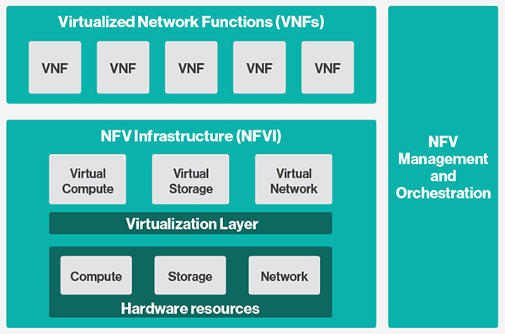
1.3 - nfv system architecture
A Virtual Network Function (VNF) is the basic block in NFV Architecture. It virtualized network function. e.g. when a router is virtualized, we call it Router VNF and when a base station is virtual we call it as base station VNF.
NFV Infrastructure (NFVI) is the totality of hardware and software components which build up the environment in which VNFs are deployed, managed and executed. NFV infrastructure physically can span across several locations, the network provides connectivity between these locations to be part of NFV infrastructure.
NFV Infrastructure includes following :
- Virtual Resources
- Virtualization Layer
- Hardware Resources
Virtualization Layer also known as a hypervisor, it abstracts the hardware resources and decouples the VNF software from the underlying hardware to ensure a hardware independent life cycle for VNFs. It is mainly responsible for following:
- Abstracting and logically partitioning physical resources, commonly as hardware abstraction layer
- Enabling the software to implement the VNF to use the underlying Virtualization Infrastructure
- Providing the virtualised resources to VNF, so that latter can be executed
The virtualization layer in middle ensures VNFs are decoupled from hardware resource and therefore software can be deployed on different physical resources.
Virtual Resources virtualization layer abstracts the computing, storage, and network from hardware layer make available as Virtual Resources.
Hardware Resource includes computing, storage and network the provides processing, storage and connectivity to VNFs through virtualization (hypervisor) layer. Computing and storage resources are commonly used in a pool.The network resource comprises of switching functions e.g. router, wired or wireless network.
Orchestrator is in charge of the orchestration and management of NFV infrastructure and software resources and realizing network services
(https://www.thousandeyes.com/learning/glossary/vnf-virtual-network-functions)

Slide 7
1.4 – VNF description
VNFs represent software implementation of network devices which are virtualized and packed in virtual machines which are scalable and movable. These VNFs are then hosted onto high end Commercial Off-the-Shelf (COTS) compute, storage and networking infrastructure. Multiple vendors are now offering VNFs as solution to present various network functions.
Some examples of VNFs are:
Edge Devices : BRAS, vCPE, IP Edge
Switching : BNG, CG-NAT, routers.
Traffic analysis : DPI, QoE measurement.
Application-level optimisation : CDNs, Load Balancers.
IoT (Internet Of Things) use cases.
Mobile network nodes : HLR/HSS, MME, SGSN, GGSN/PDN-GW, RNC.
… and so on
Multiple individual VNFs are combined together to create single super service to run in NFV environment. This way, software in form of VNFs built for different network functions can work individually or combined together, further allowing service providers to rapidly develop and deploy new services for customers and achieve growth in revenue and be competitive in respective market. We can predict that, most of the present network infrastructures in enterprises and telecom service providers will get transformed to adopt NFV architecture and top technology vendors, network equipment vendors, mid-level network software vendors will focus towards providing products, services and solutions for VNF development, on-boarding, integration & sustenance.

Slide 8
1.4 – VNF description
In my project I have analyzed in particular two types of VNFs : Load Balancer & Reverse Proxy VNFs and Message Broker VNFs
Reverse Proxy servers and Load Balancers are components in a client-server computing architecture. Both act as intermediaries in the communication between the clients and servers, performing functions that improve efficiency. They can be implemented as dedicated, purpose-built devices, but increasingly in modern web architectures they are software applications that run on commodity hardware.
The basic definitions are simple:
- A reverse proxy accepts a request from a client, forwards it to a server that can fulfill it, and returns the server’s response to the client.
- A load balancer distributes incoming client requests among a group of servers, in each case returning the response from the selected server to the appropriate client.
Even if the definitions are very similar the two concepts are not the same, both are very often related to each other (a load balancer can be a hardware device or a software application that acts as a reverse proxy and maintains the load over the servers by redirecting an adequate amount of traffic towards it.) , in fact the VNFs that I will analyze have both functions..
A Message Broker is software that enables applications, systems, and services to communicate with each other and exchange information. The message broker does this by translating messages between formal messaging protocols. This allows interdependent services to “talk” with one another directly, even if they were written in different languages or implemented on different platforms. They can can validate, store, route, and deliver messages to the appropriate destinations. One example of message broker it can be the MQTT is the most commonly used messaging protocol for the Internet of Things (IoT). MQTT stands for MQ Telemetry Transport. The protocol is a set of rules that defines how IoT devices can publish and subscribe to data over the Internet. MQTT is used for messaging and data exchange between IoT and industrial IoT (IIoT) devices, such as embedded devices, sensors, industrial PLCs, etc.

Slide 9



1.5 - LoAD BALANCER PROXY VNFS - description
NGINX is a web server designed for use cases involving high volumes of traffic. It’s a popular, lightweight, high-performance solution.
Utilizes an asynchronous event-driven model, delivering reliable performance under significant loads. It can act as a reverse proxy, as a TCP / UDP proxy, as an e-mail proxy and as a load balancer. These features have favored its widespread diffusion, using it above all as a reverse proxy or load balancer.
(https://www.nginx.com/)
HAProxy is a free, very fast and reliable reverse-proxy offering high availability, load balancing, and proxying for TCP and HTTP-based applications. It is particularly suited for very high traffic web sites and powers a significant portion of the world's most visited ones. Over the years it has become the de-facto standard opensource load balancer, is now shipped with most mainstream Linux distributions, and is often deployed by default in cloud platforms.
(http://www.haproxy.org/)
Squid is a Linux-based proxy application. The Squid proxy server is used for filtering traffic, security, and DNS lookups. Also, Squid can speed up a web server by caching resources. The Squid Proxy allows a server to cache frequently visited web pages.
(https://github.com/topics/squid-vnf)

Slide 10
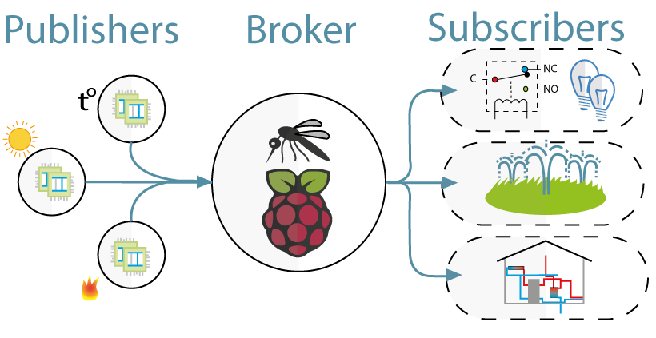

1.5 - mqtt mosquitto broker vnf - description
The MQTT it’s a protocol that provides a lightweight method of carrying out messaging using a publish/subscribe model. This makes it suitable for Internet of Things(IoT) messaging such as with low power sensors or mobile devices such as phones, embedded computers or microcontrollers.
(https://it.wikipedia.org/wiki/MQTT)
Mosquitto is an open source (EPL/EDL licensed) message broker that implements the MQTT protocol versions 5.0, 3.1.1 and 3.1. Mosquitto is lightweight and is suitable for use on all devices from low power single board computers to full servers.
The Mosquitto project also provides a C library for implementing MQTT clients, and the very popular mosquitto_pub and mosquitto_sub command line MQTT clients.
(https://mosquitto.org/)

Slide 11

CHAPTER 2 - DATA EXPLORATION/ANALYSIS
SECTIONS :
2.1 – What is it for and why do data exploration/analysis?
2.2 – Tools used for the data analysis
2.3 – Exploration of datasets
2.4 – Explanation of metrics (common and non-common)
2.5 – Correlation analysis of VNFs
2.6 – Chart analysis of VNFs

Slide 12
2.1 – What is it for and why do data exploration/analysis?
What is Data Exploration?
Data exploration is the first step of data analysis used to explore and visualize data to uncover insights from the start or identify areas or patterns to dig into more. Using interactive dashboards and point-and-click data exploration, users can better understand the bigger picture and get to insights faster.
Why is Data Exploration Important?
Starting with data exploration helps users to make better decisions on where to dig deeper into the data and to take a broad understanding of the business when asking more detailed questions later. With a user-friendly interface, anyone across an organization can familiarize themselves with the data, discover patterns, and generate thoughtful questions that may spur on deeper, valuable analysis.
Data exploration and visual analytics tools build understanding, empowering users to explore data in any visualization. This approach speeds up time to answers and deepens users’ understanding by covering more ground in less time. Data exploration is important for this reason because it democratizes access to data and provides governed self-service analytics. Furthermore, businesses can accelerate data exploration by provisioning and delivering data through visual data smarts that are easy to explore and use.

Slide 13




2.2 - tools used for the data ANALysis
All the tools described were used to carry out the project.
DEVICE SPECIFICATIONS :
PC type : HP Elitebook
Processor : Intel(R) Core(TM) i7-10610U CPU @ 1.80GHz 2.30 GHz
Installed RAM : 16.0 GB (15.8 GB usable)
Operative System : Windows 10 Enterprise
CODING :
Programming language used : Python v. 3.10.5 (https://www.python.org/ )
Text editor used : Visual Studio Code (https://code.visualstudio.com/) + Jupyter Notebook (https://jupyter.org/)
Python library used :
Pandas v. 1.4.3 (https://pandas.pydata.org/)
Seaborn v. 11.2 (https://seaborn.pydata.org/)
Matplotlib v. 3.5.3 (https://matplotlib.org/)
ML librarys (that I have described in the following slides)
All three libraries were used to visualize the data
Matplotlib provides full control over the plot to make plot customisation easy, but what it lacks is built in support for pandas. Seaborn is a data visualisation library built on top of matplotlib and closely integrated with Pandas.

Slide 14

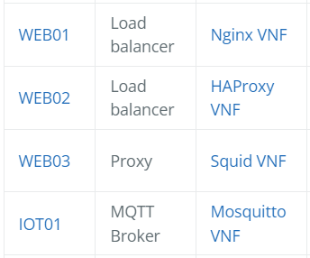
2.3 - Exploration of datasets
I’m working on collection of open data sets to support ML research in the NFV and SDN domain that are in SoftNet Data Zoo page (https://sndzoo.github.io/)
Experiment name
Experiment start
Experiment stop
ID experiment
Transf bytes/data
Request per second
Server port/host
Server version
Transfer rate kbyte per second
Tx/Rx errors
...
...
...
x 305 metrics -> that i will describe shortly
DATASET NAME CLASS TYPE
...
...
...
The softwarised network data zoo is an open collection of software networking data sets aiming to streamline and ease machine learning research in the software networking domain. Most of the published data sets focus on, but are not limited to, the performance of virtualised network functions (VNFs).
For each TYPE of VNF we have many metrics enclosed in a .CSV file.
(All CSV files have the same structure for the 4 VNFs)
In short :
We will find different experiments for each line of the csv (which last an average of 1 minute) and for each of them various types of metrics are reported (ex: bytes transmitted / received, number of packets tx / rx ... per exp in a certain period of time)

Slide 15
2.3 - Exploration of datasets
The first thing I did was to open the CSV file and be able to understand the meaning of all the columns that belong to the dataset. This phase was by no means easy as there was no document present that made me understand the specific meaning of the metrics. So once analyzed column by column I decided to create the paper where all the metrics are briefly described one by one. (The paper can be downloaded by clicking on the image on the right)
VNF type | Number of colums (metrics) | Number of rows (experiments) | Number of NULL colums | Number of colums with same values | Number of potentially usable metrics
NGINIX | 305 | 1600 | 10 | 246 | 49
HAproxy | 305 | 1600 | 10 | 246 | 49
SQUID | 305 | 1600 | 10 | 246 | 49
Mosquitto | 312 | 1600 | 14 | 243 | 55
SAME STRUCTURE

Slide 16
2.4 - Common metrics FOR LoAD BALANCER PROXY VNFS
for each VNF we have the same metrics analyzed in different cases(Status Network Interfaces).
types of Network Interfaces :
ETH0 : is the first Ethernet interface on the system. This type of interface is usually a NIC connected to the network by a category 5 cable
LO : is the loopback interface. This is a special network interface that the system uses to communicate with itself.
MGMT : management ports are used to configure, maintain, and support a network device. Often times this management interface will be connected to a dedicated and segregated VLAN used only by IT for management of network hardware.
GENERAL : that puts them all in common in a single calculation.
METRICS (Network Interfaces ) IN COMMON :
for stat in Network_Interfaces ->[ ETH0, LO, MGMT, GENERAL ] :
stat_collisions , stat_multicast , stat_rx_bytes , stat_rx_compressed , stat_rx_crc_errors , stat_rx_dropped , stat_rx_errors , stat_rx_fifo_errors , stat_rx_frame_errors , stat_rx_length_errors , stat_rx_missed_errors , stat_rx_over_errors , stat_rx_packets , stat_tx_aborted_errors , stat_tx_bytes , stat_carrier_errors , stat_tx_compressed , stat_tx_dropped , stat_tx_errors , stat_tx_fifo_errors , stat_tx_heartbeat_errors , stat_tx_packets , stat_tx_window_errors
end

Slide 17

2.4 - Common ab metrics for each vnFS
for each vnf we have the same metrics about the “ ab “ (Apache Benchmark tool)
Apache Benchmark represent a tool for benchmarking your Apache Hypertext Transfer Protocol (HTTP) server. It is designed to give you an impression of how your current Apache installation performs. This especially shows you how many requests per second your Apache installation is capable of serving. All of this metrics start with the prefix “ab” (linux command to represent apachebench) (https://httpd.apache.org/docs/2.4/programs/ab.html )
METRICS (ab) IN COMMON
ab_completed_requests , ab_current_lvl , ab_doc_length , ab_doc_path , ab_failed_requests , ab_failed_requests , ab_html_trasnfer_byte , ab_mean_time_per_requests , ab_request_per_second , ab_rt_percentiles_csv , ab_srv_host , ab_srv_port , ab_srv_version , ab_time_used_s , ab_total_total_transfer_byte , ab_transfer_rate_kbyte_per_second

Slide 18
2.4 - Some descriptions of important metrics (vnf)
Analyzing the dataset I chose some useful metrics to perform the experiments and graph the data. In this case the datasets are similar and for all three experiments I have chosen the same features and renamed to have more order.
The metrics in question concern both NGINX , HAPROXY and SQUID having similar properties, the metrics of these 3 VNF are all common. While they change compared to those of MQTT Mosquitto
Since the metrics present in the various CSVs are many, I have created a pdf file where ALL are explained in detail :
file:///C:/Users/giovanna/Downloads/HPe_VNF_description.pdf
Metrics NGINX/HAPROXY/SQUID | Simple rename | Description
param__func__mp.input__cmd_start | size | size of packet in one experiment (only two different parameters : Big or Small the parameters changes according to the content transmitted in the packet )
param__func__de.upb.lb-nginx.0.1__cpu_bw * | cpu_bw | the rate at which data can be read from or stored into a semiconductor memory by a processor
param__func__de.upb.lb-nginx.0.1__mem_max * | mem | max memory used expressed in MByte
metric__mp.input.vdu01.0__ab_request_per_second | requests_per_second | number of requests per second , is a measure of the amount of search traffic an information retrieval system receives in one second
metric__mp.input.vdu01.0__ab_completed_requests | completed_requests | number of successful responses received
metric__mp.input.vdu01.0__ab_failed_requests | failed_requests | number of failed requests
metric_stat_data_rx_bytes/tx_bytes | rx_bytes/tx_bytes | the number of received and transmitted packets
metric__mp.input.vdu01.0__ab_mean_time_per_request | mean_time_per_request | the average amount of time it took for a single request to process by itself
metric__mp.input.vdu01.0__ab_total_transfer_byte | total_transfer_byte | the total number of bytes received from the server. This number is essentially the number of bytes sent over the wire
metric_stat_data_collisions | collisions | number of collisions during packet transmissions
** examle based on nginx, for haproxy and squid change only the name in the 2 and 3 metrics in this way (param__func__de.upb.lb-hproxy.0.1__cpu_bw , param__func__de.upb.lb-squid.0.1__cpu_bw) same for mem_max

Slide 19
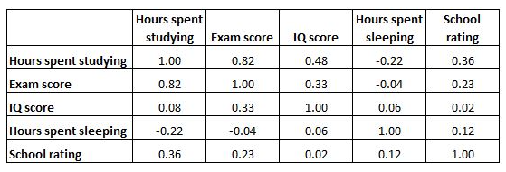
CORRELATION MATRICES STUDIES
What is the correlation matrix?
Before understanding what the correlation matrix is, it is necessary to understand what correlation is : a measure that indicates the linear relationship between two random variables. It is always between -1 and 1, where :
-1 means that the two variables have an inverse linear relationship, i.e. as one increases, the other decreases
1 means that the two variables have a direct linear relationship, that is, as one increases, the other increases as well
0 means that it is not possible to establish a linear trend between the two variables
in some cases we want to understand the correlation between more than just one pair of variables. In these cases, we can create a correlation matrix, which is a square table that shows the correlation coefficients between several variables. It is a powerful tool to summarize a large dataset and to identify and visualize patterns in the given data.
Example of Correlation Matrix
Each cell in the table shows the correlation between two specific variables.
The correlation matrix below shows the correlation coefficients between several variables related to education:
The cell highlighted in red shows that the correlation between "hours spent studying" and "exam score" is 0.82, which indicates that they are strongly positively correlated. More hours spent studying strongly correlates with higher exam scores.
The cell highlighted in blue shows that the correlation between "hours spent studying" and "hours spent sleeping" is -0.22, which indicates that they are weakly negatively correlated. More hours spent studying are associated with fewer hours spent sleeping.
The cell highlighted in green shows that the correlation between "hours spent sleeping" and "IQ score" is 0.06, which indicates that they are essentially unrelated. There is very little association between the number of hours a student sleeps and her IQ score.
The correlation coefficients along the diagonal of the table are all equal to 1 because each variable is perfectly correlated with itself. These cells aren’t useful for interpretation.
Notice that a correlation matrix is perfectly symmetrical.

Slide 20
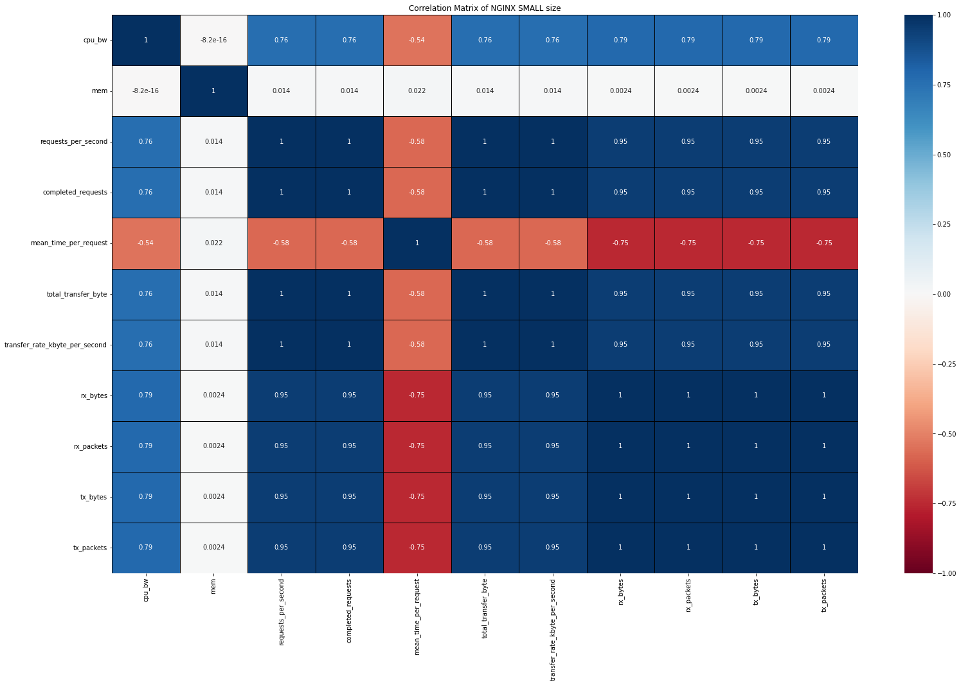
CORR. MATRIX OF IMPORTANT METRICS (NGINX SMALL SIZE of packets)
This is the correlation matrix that I have generated in python concerning the NGINX VNF (only the part relating to small size packages), I have selected 11 variables and they are the most important in the datasets. In this case, similar statements can be made to the ones I showed earlier in the example(education).
For example :
cpu_bw is positively correlated with the rx / tx packets, in fact I expected it because the use of it increases as the rx / tx packets increase. I can drop rx/tx packets/bytes are all the same.. I can only keep one of these 4.
mem : is not correlated with anything in fact it seems to be a useless variable for the study.

Slide 21
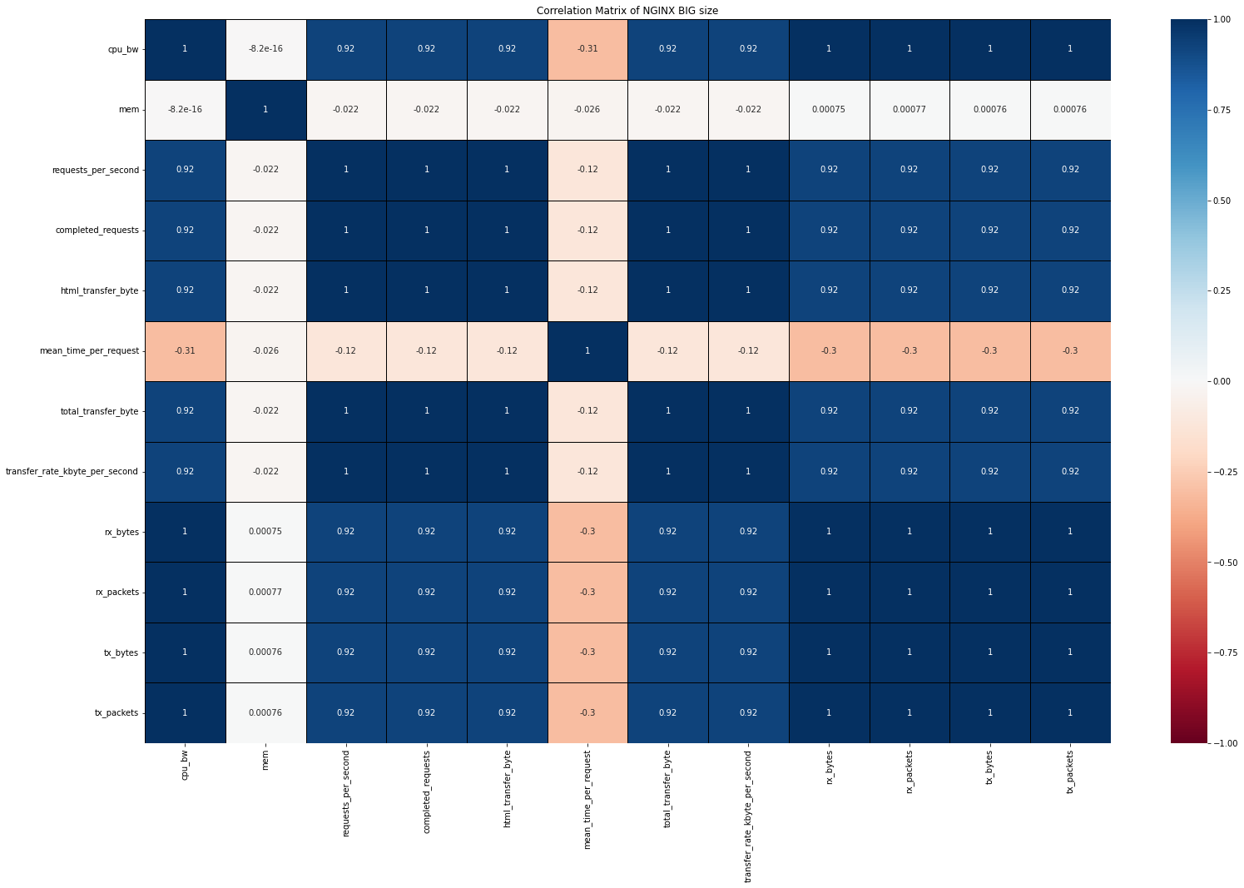
CORR. MATRIX OF IMPORTANT METRICS (NGINX BIG SIZE of packets)
This is the correlation matrix about NGINX big size of packets. We can see some important difference between the small size. First we have one more variables “ html_transfer_byte “(in the small case the html values were all null so I have not graphed them ). And then the values of correlation in this case are more higher respect the small size.
In these cases (graphs) the structures all the same, the graph easily gives us a quickly understand the correlations between each pair of variables , and a big idea about your datasets.

Slide 22
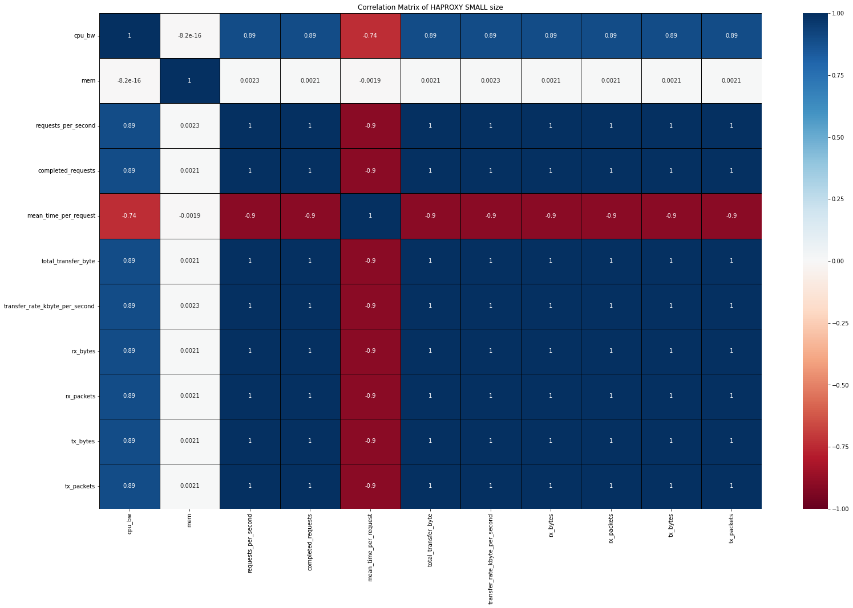
CORR. MATRIX OF IMPORTANT METRICS (HAPROXY SMALL SIZE OF PACKETS )
This is the correlation matrix that I have generated in python concerning the HAPROXY VNF (only the part relating to small size packages), I have selected 11 variables and they are the most important in the datasets. In this case, similar statements can be made to the ones I showed earlier in the example(education).
Comments very similar to the previous ones…
For example :
mean_time_requests : is negatively correlated to all other variables, the mean_time_requests (processing time of a request) decreases as the CPU allocation increases.

Slide 23
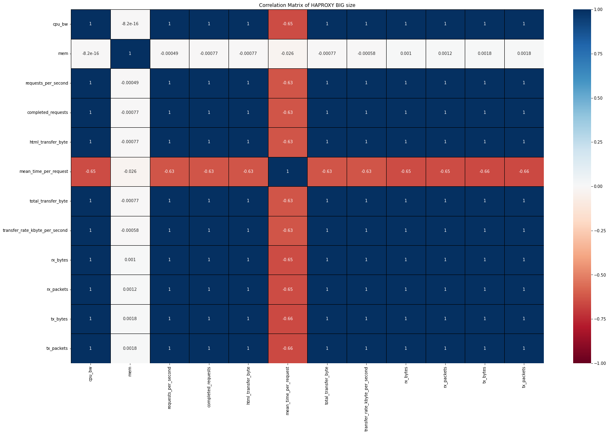
CORR. MATRIX OF IMPORTANT METRICS (HAPROXY BIG SIZE OF PACKETS )
This is the correlation matrix about HAPROXY big size of packets. We can see some important difference between the small size. First we have one more variables “ html_transfer_byte “(in the small case the html values were all null so I have not graphed them ). And then the values of correlation in this case are more higher respect the small size. There’s a lot of 1 in the matrix.
-8.2e-16 == 0
we find this value in the matrices , represents a very small value, we can approximate it to 0 .

Slide 24
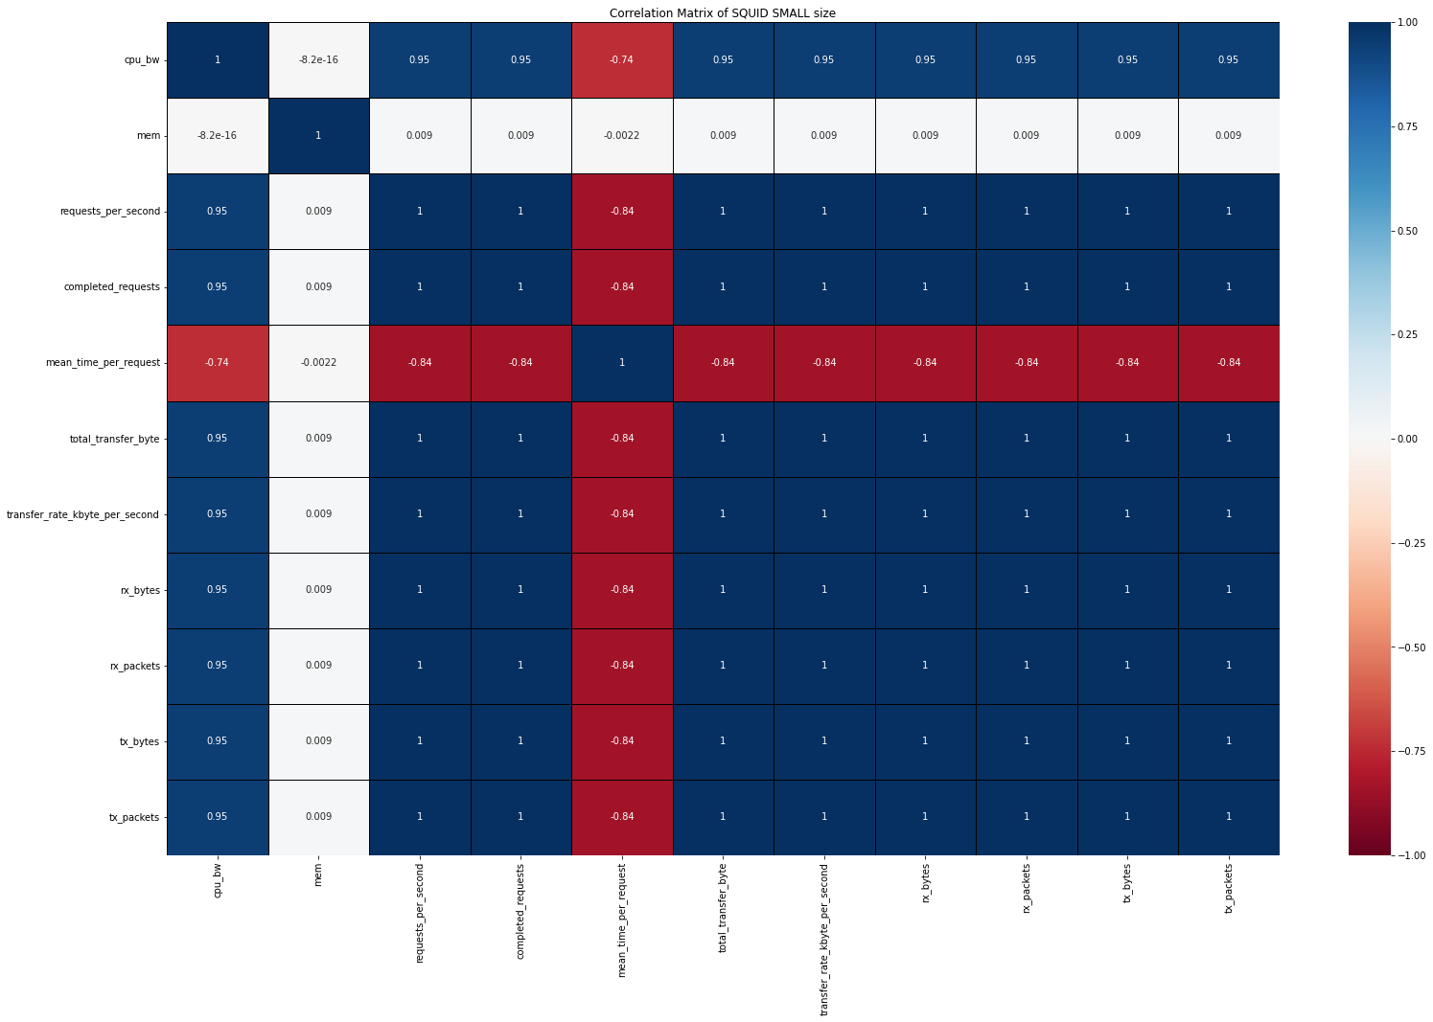
CORR. MATRIX OF IMPORTANT METRICS (SQUID SMALL SIZE OF PACKETS)
This is the correlation matrix that I have generated in python concerning the SQUID VNF (only the part relating to small size packages), I have selected 11 variables and they are the most important in the datasets. In this case, similar statements can be made to the ones I showed earlier in the example(education).
This matrix it’s very similar to HAPROXY small size.

Slide 25
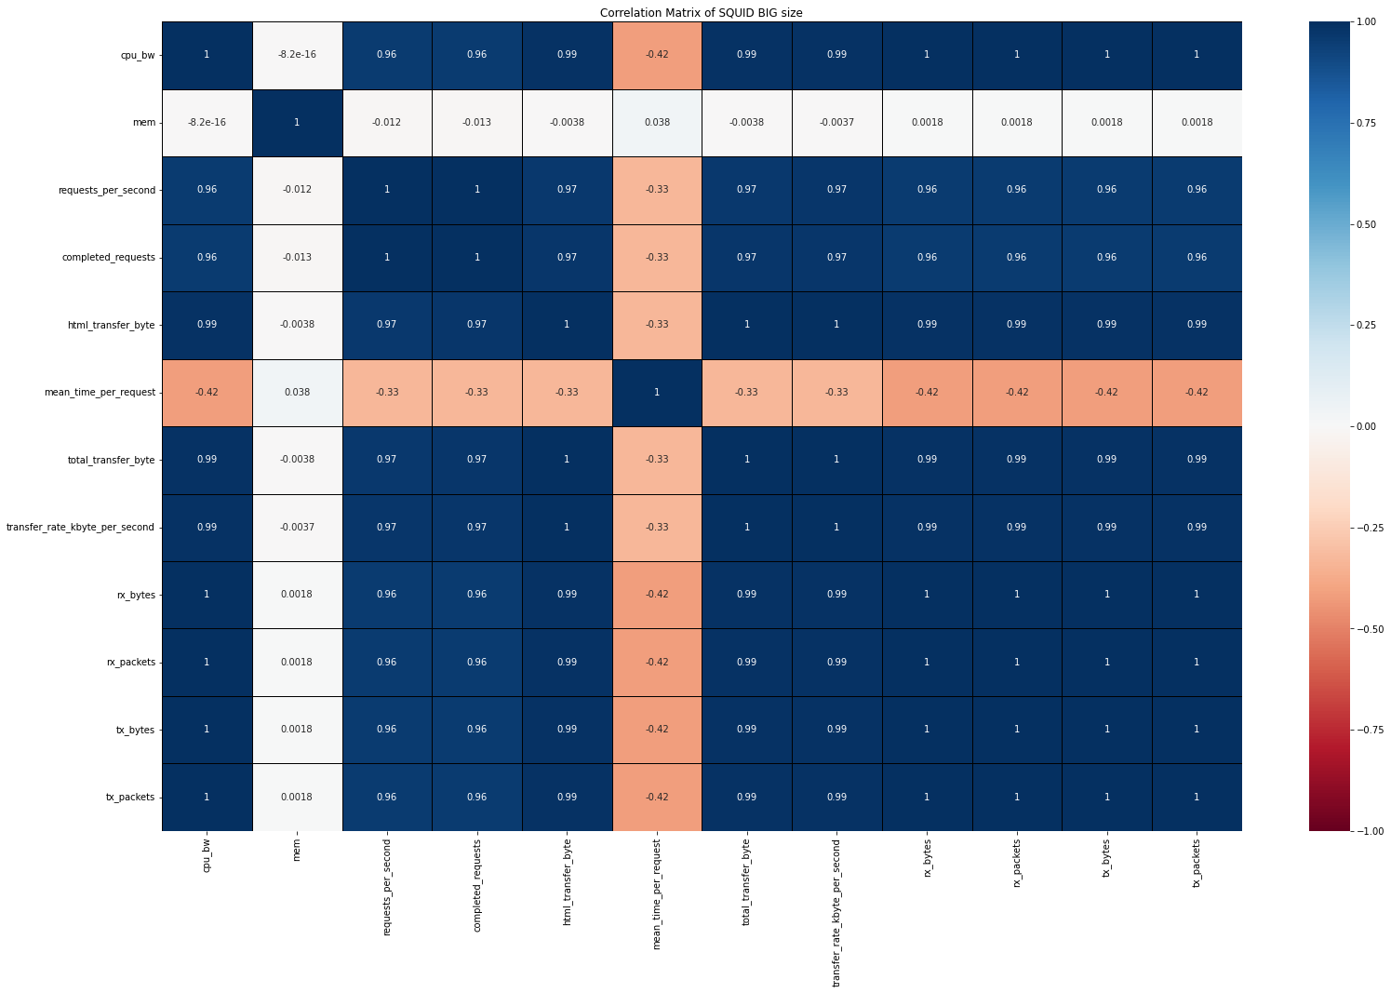
CORR. MATRIX OF IMPORTANT METRICS (SQUID big SIZE OF PACKETS)
This is the correlation matrix about SQUID big size of packets. We can see some important difference between the small size. First we have one more variables “ html_transfer_byte “(in the small case the html values were all null so I have not graphed them ).
It can be seen that the correlation with mean_time_per_request is much closer to zero than the HAproxy

Slide 26
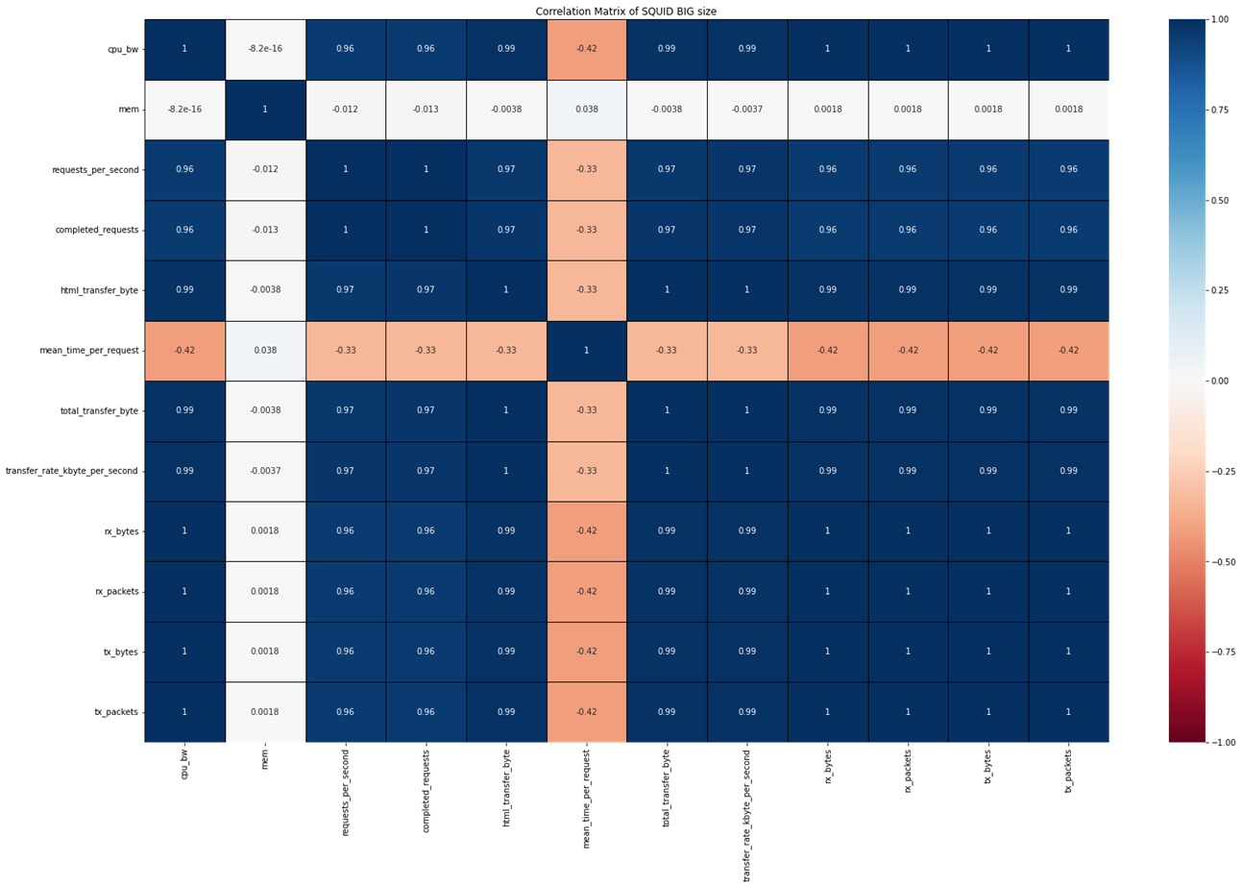
Corr. Matrices – comments
A high correlation points to a strong relationship between the two variables, while a low correlation means that the variables are weakly related.
If two variables are highly correlated, we can just keep just one of them in order to be able to characterize a VNF.
For NGINX, HAproxy and SQUID there are many highly correlated features so the final analysis, which I will explain better in the following slides, will include the use of a few (unrelated) features such as “memory” or “mean time per request” .
In general, it is recommended to avoid having correlated features in your dataset. Indeed, a group of highly correlated features will not bring additional information (or just very few), but will increase the complexity of the algorithm, thus increasing the risk of errors.
In the previous slides there are cases of this type, keeping both features (completed_requests, html_transfer_byte) for the final study would be useless. Because they would only provide more information that the system already knows very well (example: it is assumed that the transferred bytes grow as the cpu_bw increases in fact as we can see in 96% of cases this happens!).
The same for the completed requests. It's as if both features tell us the same thing . So I can only keep one of the two features indicated
cpu_bw memory req. per second ... ... ...

Slide 27
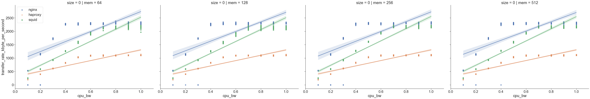
VNF CHARTS - description
To graph the data I decided to use the Seaborn library and specifically the graphs of the lmplot type (https://seaborn.pydata.org/generated/seaborn.lmplot.html). The generated graphs are consistent with the correlation studies done (we will see later) .
Every plot in Seaborn has a set of fixed parameters. For sns.lmplot(), we have three mandatory parameters and the rest are optional that we may use as per our requirements. These 3 parameters are values for X-axis, values for Y-axis and reference to dataset. These 3 are pre-dominantly visible in almost all of Seaborn plots and in addition, there is an optional parameter it comes in very handy. This is hue parameter and it takes in categorical columns and kind of helps us to group our data plot as per hue parameter values. Let us see how it works :
sns.lmplot(x="cpu_bw", y="tranfer_rate_kbyte_per_second", data=dataset, hue="vnf", col="mem", row="size")
This declaration made in python generates the left graph , in the x-axis we have cpu bandwith , in the y-axis the transfer rate kybte per second , the data field contains all the dataset, hue field contains the three different types of VNFs (nginx, haproxy, squid) , col field contains 4 types of memory we have 4 types of charts based on memory (64,128,256,512) , row field represent the size of packets we have 0 for the small size and 1 for the big size in this case I generated the graphs for both sizes, as I did for the correlation matrices.

Slide 28
VNF CHARTS - description
These lines in our graph are the best fit available for the trendof the transfer rate kbyte per second with respect to the cpu bandwidth. And the data points that we see at extreme bottom left which are far away from this line are known as outliers in the dataset. We may think of outliers as exceptions.
Goal of Data Science is to predict the best fit for understanding the trend in behavior of visiting customers and our algorithm shall be always designed accordingly. We may find this a common scenario while applying generalized linear models in Machine Learning. If we very closely notice, there is this shadow converging at the center where there is a chunk of our data. This convergent point is actually the statistical mean or in simpler words, the generalized prediction.
shadow converging
outliers

Slide 29
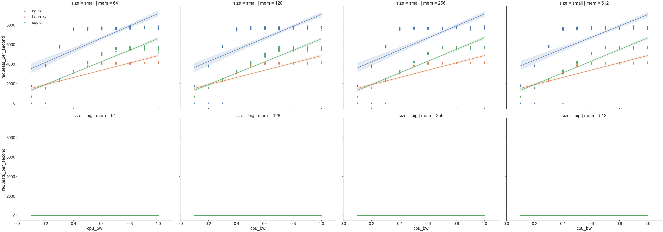
VNF CHARTS – small size (1)
REQUESTS PER SECOND
I generated the graphs (lmplot) related to the requests per second (Y-axis) and cpu bandwidth (X-axis) , as you can see in this case NGINX provides better performance than HAproxy / Squid.
NOTE : at the same level of CPU utilization (0.8 is 80%) NGINX can handle about 8000 requests while it has HAproxy 2500 and Squid about 5000 . At 20% of CPU bandwith Squid and HAproxy handle the same number of request per second. As requests per second grow, the use of the cpu bandwith grows, in fact the correlation between cpu_bw and requests_per_second was positive (as seen in the slide 14) . I also generated the graphs based on the mem, but as we can see the changes are minimal, the outliers increase as the memory grows.

Slide 30
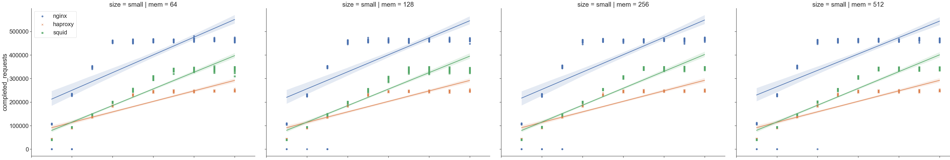
VNF CHARTS – small size (2)
COMPLETED REQUESTS
I generated the graphs (lmplot) related to the completed requests (Y-axis) and cpu bandwidth (X-axis) , as you can see in this case NGINX completes many more requests with the same CPU usage than HAproxy / Squid . We can make comments very similar to those made for the previous graphs . I also generated the graphs based on the mem, but as we can see the changes are minimal, the outliers increase as the memory grows.

Slide 31
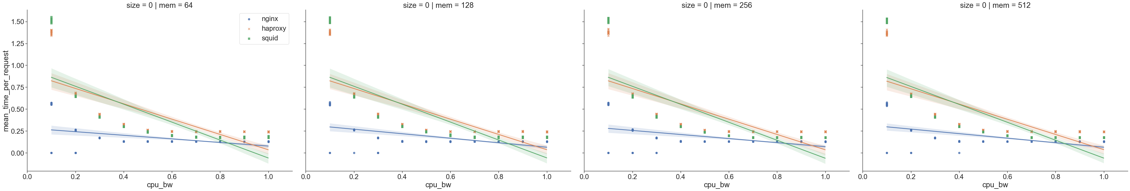
VNF CHARTS - SMALL SIZE (3)
MEAN TIME PER REQUEST
The mean_time_per_requests tells you the average amount of time it took for a concurrent group of requests to process. Time per request (mean, across all concurrent requests) . As cpu usage increases, the mean time of requests decreases. The result obtained is consistent with that seen in all the correlations matrix (negative number).
NOTE : from 0 to 20% of cpu usage the mean time per requests is much lower for nginx than peer squid and haproxy (they are more or less on the same level) while from 80 to 100% of cpu usage the mean time per requests is very low for all three VNFs .

Slide 32
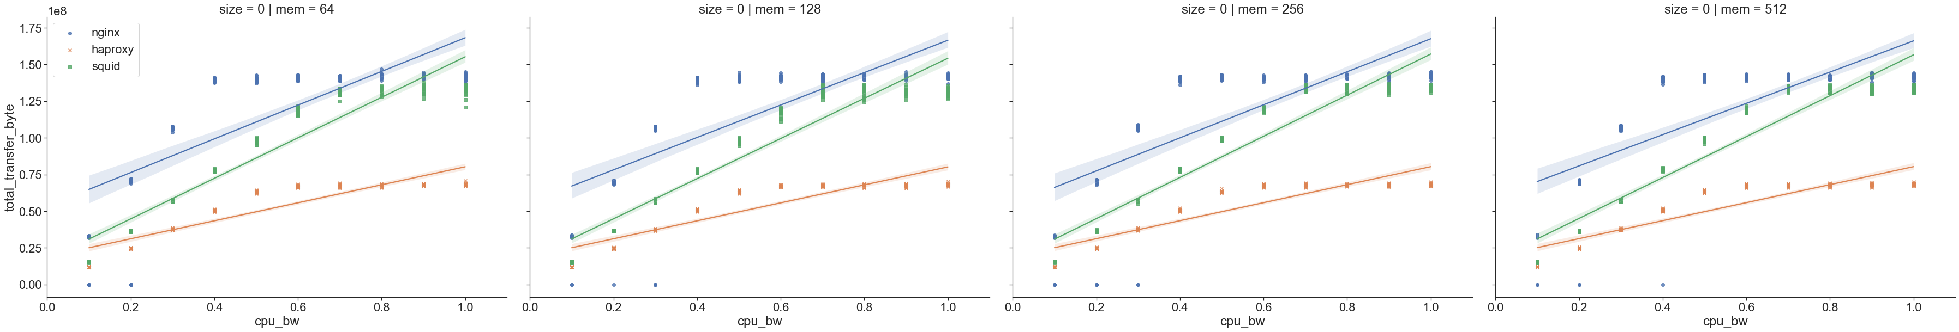
VNF CHARTS – small size (4)
TOTAL TRANSFER BYTE
The same of kbyte per second but here we have byte on the Y-axis

Slide 33
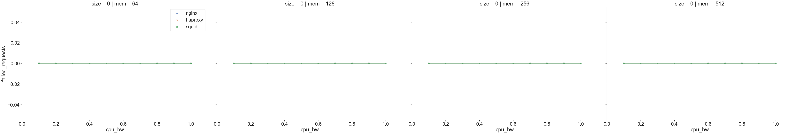
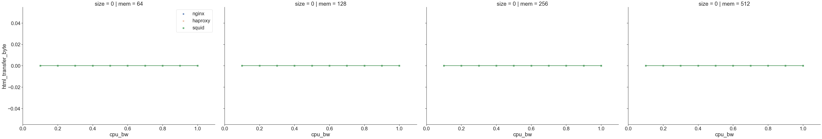
VNF CHARTS – Small size (4)
TRASNFER RATE KBYTE PER SECOND
FAILED REQUESTS
HTML TRANSFER BYTE
NOTES : In the graphs above we can see how the cpu bandwidth increases as the kbytes transferred per second increase. In this case, nginx and squid have very similar trends when more than 70% of cpu is used .
Obtained the same results (but with different scales) when I set the bytes per second (instead of the kbytes) in the Y-axis.
NOTES : for the failed requests parameter and html transfer byte, in the small cases we have all NaN values (with 64,128,256,512) , as we can see in the images. It means that we don't have never failed requests and don't have html transfer byte in the small size cases

Slide 34
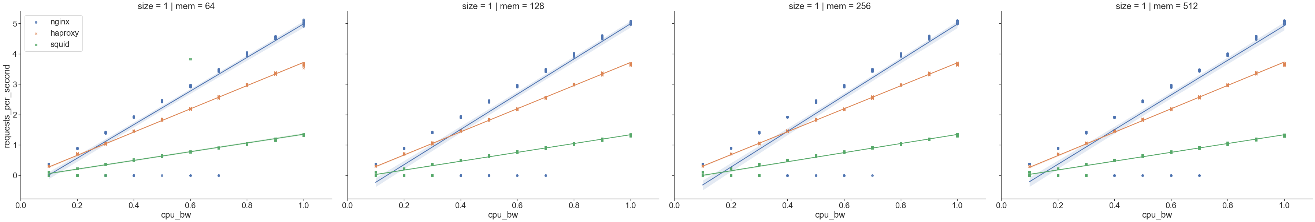
VNF CHARTS – big size (1)
REQUESTS PER SECOND
IMPORTANT : From this slide on there will be all the graphs concerning the big size of the packages. Often many comments made for the small size are identical, just look at the similarity between the previous graphs. The biggest difference can be seen in the Y axis, the scale of values is different in each graph.
I generated the graphs (lmplot) related to the requests per second (Y-axis) and cpu bandwidth (X-axis) , as you can see in this case NGINX provides better performance than HAproxy / Squid
NOTE : the requests per second are much less frequent than the size small, in fact we can see that in the Y-axis of the graph it goes from 0 to 5 while for the small it went from 0 to 8000. The performances of the 3 vnf remain the same as those seen for the small size therefore (nginx dominates), also you may notice that nginix has a lot of outliners.

Slide 35
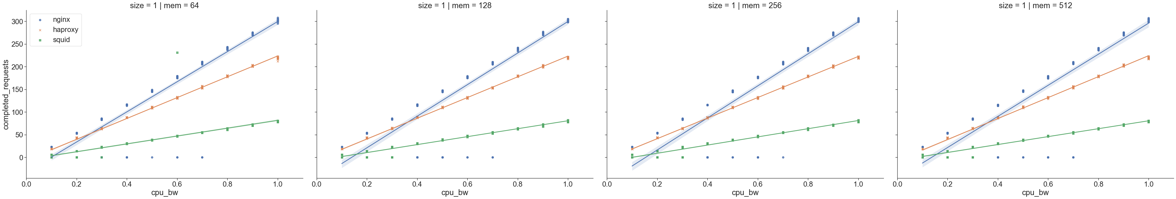
VNF CHARTS – big size (2)
COMPLETED REQUESTS
NOTE : I generated the graphs (lmplot) related to the completed requests (Y-axis) and cpu bandwidth (X-axis) , as you can see in this case NGINX completes many more requests with the same CPU usage than HAproxy / Squid . The completed requests are much lower in the big size than in the small (in the hundreds, while for the small in the thousands). Same comments related to small size, here with 80 to 90 % of cpu usage 220 – 260 requests are complete , in the small size with the same cpu usage 400.000 – 450.000 requests! There are several outliers for the nginx part

Slide 36
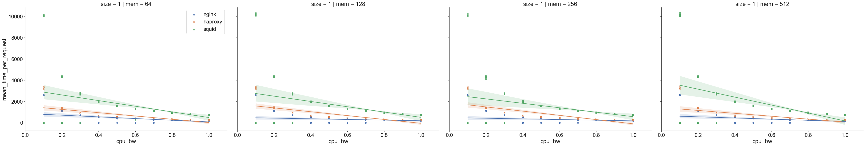
VNF CHARTS – big size (2)
MEAN TIME PER REQUEST
The mean_time_per_requests tells you the average amount of time it took for a concurrent group of requests to process. Time per request (mean, across all concurrent requests) . As cpu usage increases, the mean time of requests decreases. The result obtained is consistent with that seen in all the correlations matrix (negative number).
NOTE : In the big size the mean time per requests is very big respect the small size because large packets take longer to process, otherwise the same comments made in the small case apply.

Slide 37
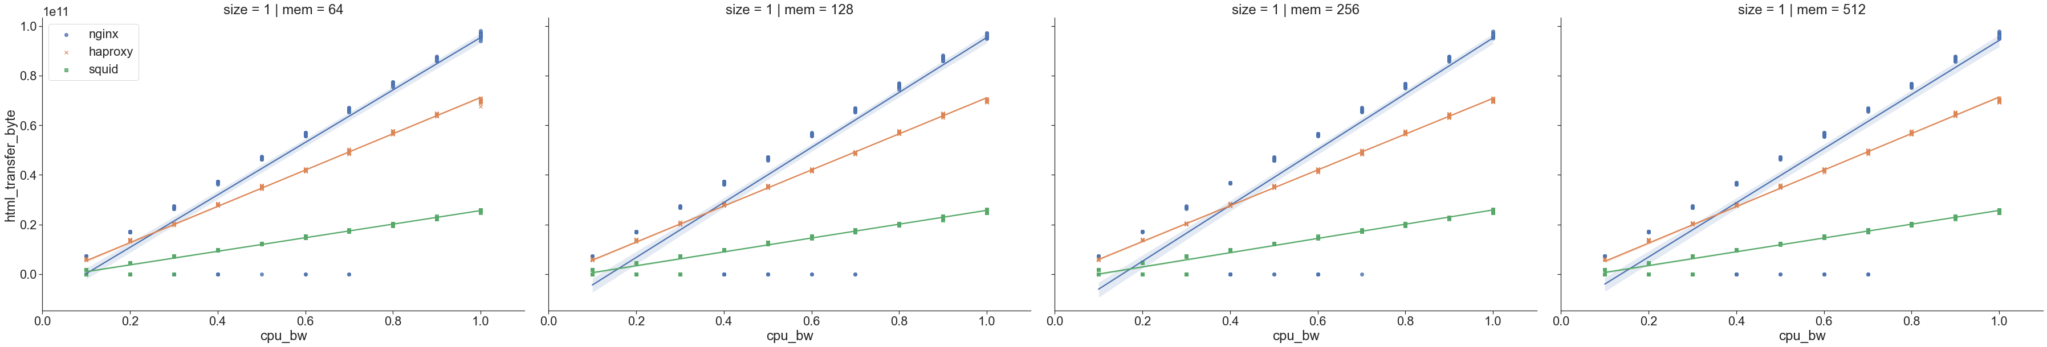
VNF CHARTS – BIG SIZE (3)
HTML TRANSFER BYTE
The graphs relating to html transfer byte it was possible to create them only for the big size part. In this case the Y-axis contains a very large scale of values, 1e11 means 100000000000. In fact, the bytes transferred are many more when the size of each single packet increases. Also in this case for the same use of the cpu bandwidth in the 3 cases nginx dominates, then follows haproxy and lastly squid which only manages to process less than half of the packets (compared to the other two vnf) referring to the use of the cpu that goes from 80 to 100% . In the lower left part of the graph we can see many outliers.

Slide 38

VNF CHARTS – big size (4)
TOTAL TRANSFER BYTE
In the graphs above we can see how the cpu bandwidth increases as the bytes transferred per second increase. In this case, nginx and haproxy have similar trends compare to squid. In the small size nginx and haproxy had a similar trends . It can be seen that even in this case the scale of the Y-axis is different much larger.

Slide 39
VNF CHARTS – big size (4)
FAILED REQUESTS
In this case we have only one graph with values ​​all equal to 0 (compared to the previous case “small” ) and it is the one in this slide.
MAIN DIFFERENCES BETWEEN BIG AND SMALL SIZE CHARTS
- The main difference lies in some metrics that change considerably their numerical results, for example in the SMALL size(0) the mean_time_per_requests it is much lower than the BIG size(1), as well as the transfer_rate per second (in bytes and kbytes).
- On the contrary instead the ab_requests_per_second is much larger in the SMALL size(0) compared to the BIG size(1). In fact you can see in the graphs the change of scale in the Y axis.
- In the big size we have also included the html transfer byte parameter in the small size we have all 0 values for these parameter

Slide 40
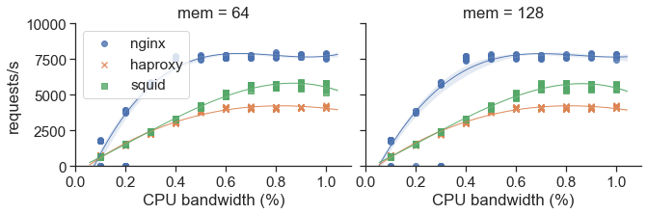
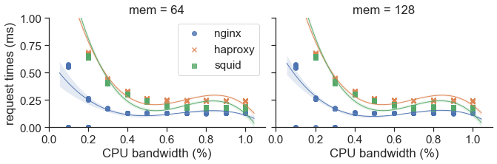
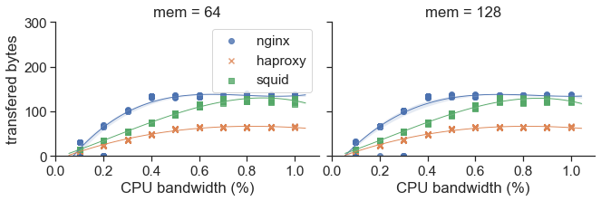
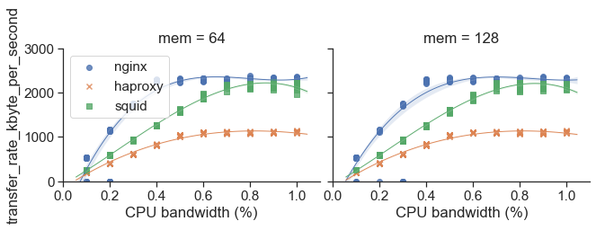
VNF CHARTS

Slide 41
Mqtt mosquitto broker - METRICS
Analyzing the dataset I chose some useful metrics to perform the experiments and graph the data. In this case the datasets are similar and for all three experiments I have chosen the same features and renamed to have more order.
The tests are based on malaria disease, which is why some metrics are prefixed with malaria!
Metrics Mosquitto VNF | Simple rename | Description
param__func__mp.input__cmd_start | req_type | this metric contains 4 types of packets that can be transmitted. Indicates the type of packet transmitted
param__func__de.upb.broker-mosquitto.0.1__cpu_bw | cpu_bw
param__func__de.upb.broker-mosquitto.0.1__mem_max | memory | Max amount of memory expressed in MByte
metric__mp.input.vdu01.0__malaria_msgs_per_sec | msg_per_second | number of messages sent per second
metric__mp.input.vdu01.0__malaria_time_mean | msg_t_mean | Relative time mean for a message
metric__mp.input.vdu01.0__malaria_time_total | mal_time_total | Time total elapsed
metric__mp.input.vdu01.0__malaria_time_stddev | msg_t_std | Relative time standard deviation for a message
metric__vnf0.vdu01.0__stat__input__rx_bytes/packets | rx_bytes/packets | Number of bytes/packets received
metric__mp.output.vdu01.0__malaria_flight_time_max | ml_ft_max | The number of "in flight" messages for QoS 1 and QoS 2 can be controlled by both the client and the broker.
metric__vnf0.vdu01.0__stat__input__tx_bytes/packets | tx_bytes/packets | Number of bytes/packets transmitted

Slide 42
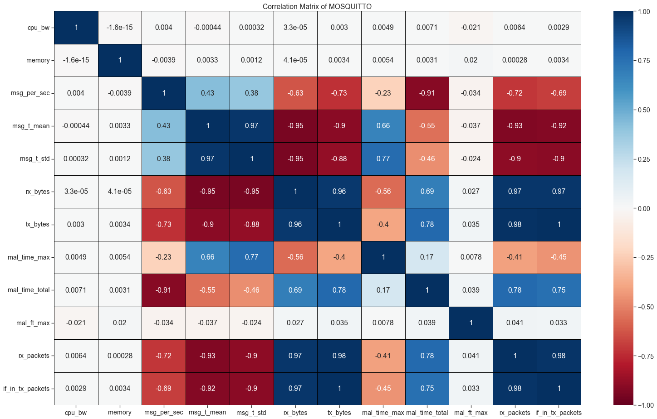
Mosquitto CORRELATION chart (1)
This is the correlation matrix we can see that the cpu bandwidth , the memory and the malaria flight time total are not correlated to anyone.

Slide 43
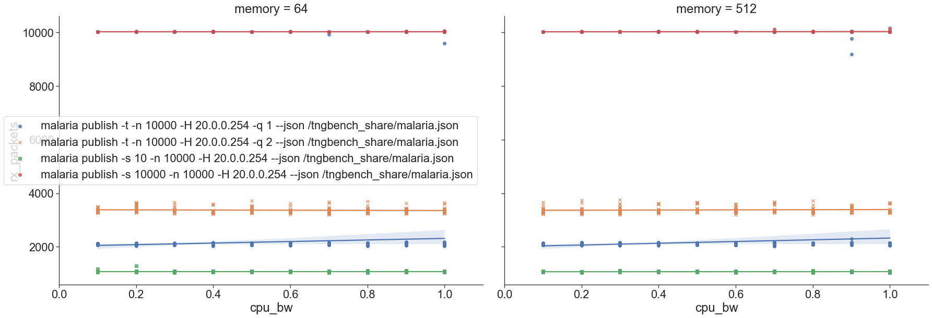
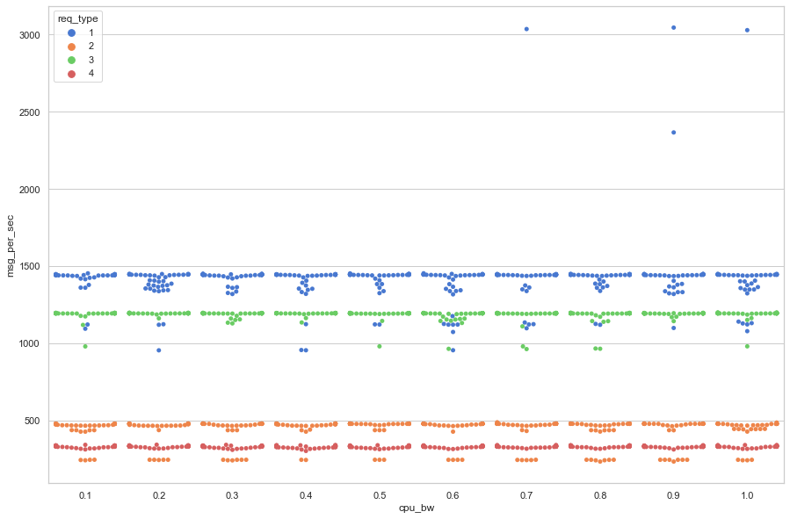
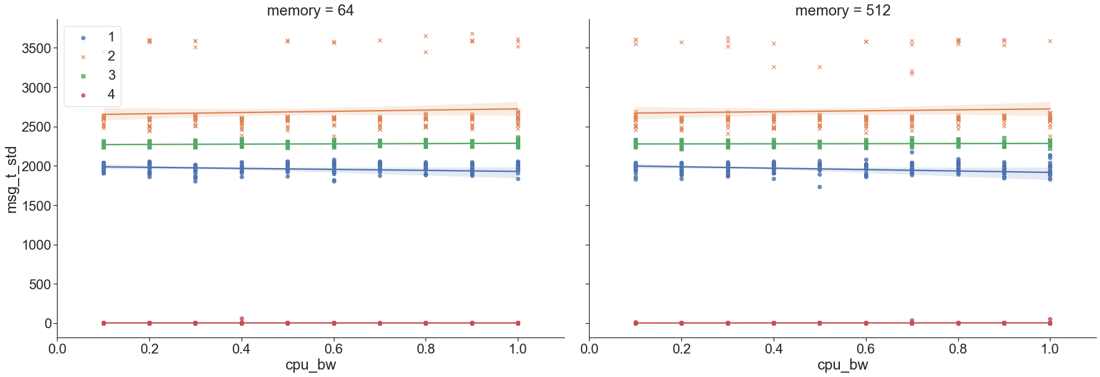
Mosquitto charts (2)
1)
2)
3)
4)
MSG PER SECOND
MALARIA TIME STDDEV

Slide 44
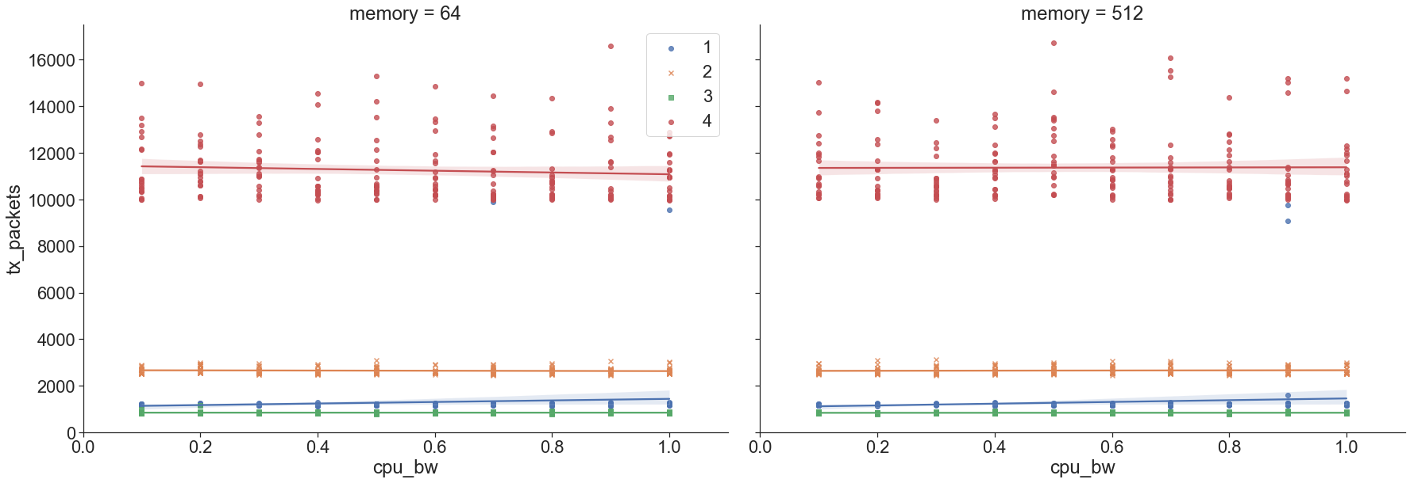
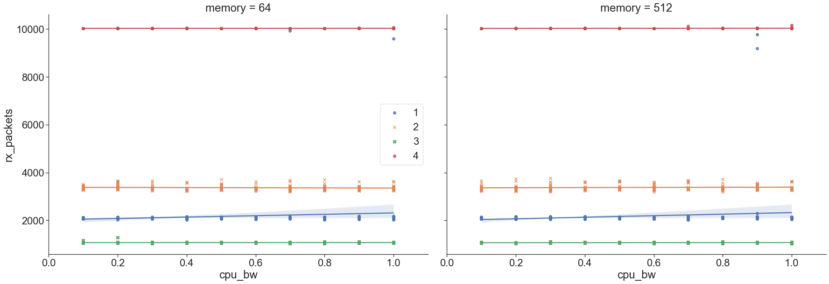
MOSQUITTO CHARTS (3)
PACKETS TRANSMITTED
PACKETS RECIVED

Slide 45
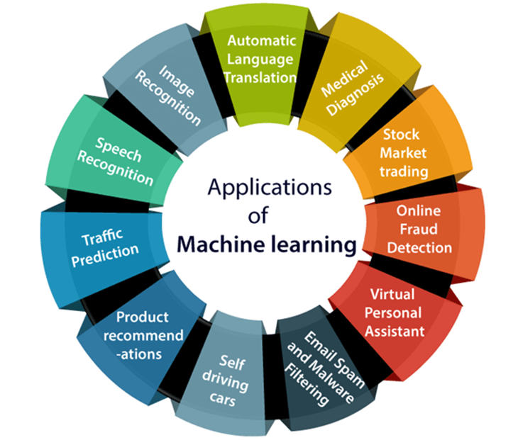
CHAPTER 3 - APPLICATION OF MACHINE LEARNING TECHNIQUES
SECTIONS :
3.1 – What is Machine Learning (ML) ? Why is used ?
3.2 – Supervised Learning and Regression techniques
3.2.1 – ML algorithms used
3.3 – How to characterize a dataset with ML

Slide 46

APPLICATION OF MACHINE LEARNING TECHNIQUES
WHAT IS THE MACHINE LEARNING ?
Machine Learning (ML) is a form of Artificial Intelligence (AI) that enables a system to learn from data rather than through explicit programming. However, machine learning is not a simple process. Machine learning uses a variety of algorithms that iteratively learn from data to improve, describe data, and predict outcomes.
WHY IS MACHINE LEARNING USED ?
there are undeniable practical advantages to machine learning, namely:
Intelligent BIG DATA management – The sheer volume and variety of data being generated as humans and other environmental forces interact with technology would be impossible to process and draw insights from without the speed and sophistication of machine learning. In fact, in our case we dealt with big data relating to the world of VNFs
Smart devices – From wearable devices that track health and fitness goals to self-driving cars to "smart cities" with infrastructure that can automatically reduce wasted time and energy, the Internet of Things (IoT) holds great promise, and machine learning can help make sense of this significant increase in data.
Rich consumer experiences – Machine learning enables search engines, web apps and other technology to customise results and recommendations to match user preferences, creating delightfully personalised experiences for consumers.
(https://catalogplayer.com/en/uncategorized/five-ways-machine-learning-can-improve-your-sales/9872/)

Slide 47

APPLICATION OF MACHINE LEARNING TECHNIQUES
Regression is a ML technique for investigating the relationship between independent variables or features and a dependent variable or outcome. It's used as a method for predictive modelling in machine learning, in which an algorithm is used to predict continuous outcomes
There are many and various algorithms, I have specifically analyzed the Random Forest and Gradient Boosting
The general mainly scope is that developing a model using historical data to make a prediction on new data where we do not have the answer.
In a mathematical way the Regression modeling is the task of approximating a mapping function (f) from input variables (x) to a continuous output variable (y).
( https://www.seldon.io/machine-learning-regression-explained )
Machine Learning is a very powerful tool that allows you to do many things. In this case, I used a technique called "regression" to study the datasets of VNF.
In our case :
x = metrics extracted
y = CPU BANDWITH

Slide 48
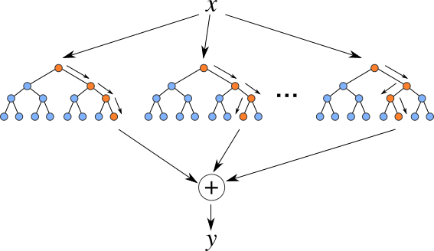
RANDOM FOREST ALGORITHM
Random Forest is a Supervised Machine Learning Algorithm that is used widely in Classification and Regression problems. It builds decision trees on different samples and takes their majority vote for classification and average in case of regression.
STEPS of Random Forest algorithm :
1) Pick at random k data points from the training set.
2) Build a decision tree associated to these k data points.
3) Choose the number N of trees you want to build and repeat steps 1 and 2.
4) For a new data point, make each one of your N-tree trees predict the value of y for the data point in question and assign the new data point to the average across all of the predicted y values.
metrics
CPU bandwith
https://en.wikipedia.org/wiki/Random_forest

Slide 49
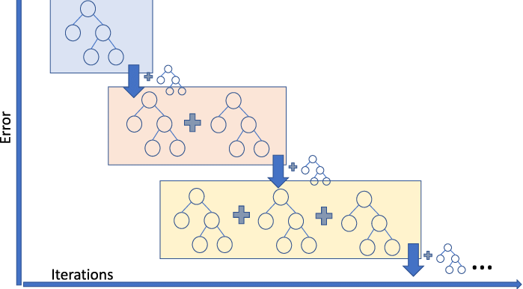
GRADIENT BOOSTING ALGORITHM
"Boosting" in machine learning is a way of combining multiple simple models into a single composite model. As we combine more and more simple models, the complete final model becomes a stronger predictor. The term "gradient" in "gradient boosting" comes from the fact that the algorithm uses gradient descent to minimize the loss.
STEPS of Gradient Boosting algorithm:
1) Make the first guess.
2) Compute the pseudo-residuals.
3) Predict the pseudo-residuals.
4) Make a prediction and compute the residuals.
5) Make a second prediction.
https://en.wikipedia.org/wiki/Gradient_boosting

Slide 50












3.3 - How to characterize a dataset with ML
DATA PREPOCESSING
MACHINE LEARNING ALGORITHMS
These steps in this slide indicate the path that the data take to then arrive at a final forecast (of what you want to analyze). This slide generally represents how Machine Learning is applied.
INPUT
RESULTS
MODEL
TRAINING DATA
OUTPUT
Prediction of CPU bandwidth

Slide 51
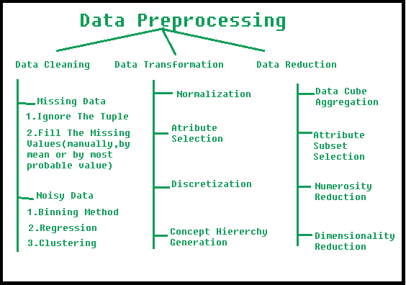
- DATA PREPROCESSING
Data Cleaning : is particularly done as part of data preprocessing to clean the data by filling missing values, smoothing the noisy data, resolving the inconsistency, and removing outliers.
Missing Data : Here are a few ways to solve this issue: - Ignore those tuples : this method should be considered when the dataset is huge and numerous missing values are present within a tuple. - Fill in the missing values : there are many methods to achieve this, such as filling in the values manually, predicting the missing values using regression method, or numerical methods like attribute mean.
Noisy Data : it involves removing a random error or variance in a measured variable. It can be done with the help of the following techniques:
- Binning : it is the technique that works on sorted data values to smoothen any noise present in it. The data is divided into equal-sized bins, and each bin/bucket is dealt with independently
- Regression : this data mining technique is generally used for prediction. It helps to smoothen noise by fitting all the data points in a regression function.
- Clustering : creation of groups/clusters from data having similar values. The values that don't lie in the cluster can be treated as noisy data and can be removed.
Data Transformation : once data clearing has been done, we need to consolidate the quality data into alternate forms by changing the value, structure, or format of data using the below-mentioned Data Transformation strategies.
Normalization : It is the most important Data Transformation technique widely used. The numerical attributes are scaled up or down to fit within a specified range.
Attribute Selection : new properties of data are created from existing attributes to help in the data mining process. For example, date of birth, data attribute can be transformed to another property like is_senior_citizen for each tuple.
Discretization : where the raw values of numeric attribute (e.g age) are replaced by interval labels (e.g 10-20, 11-20). The labels, in turn, can be recursively organized into higher-level concepts, resulting in a concept hierarchy for the numeric attribute.
Concept Hiererchy Generation : where attributes such as street can be generalized to higher-level concepts, like city or country.
Data Reduction : the size of the dataset in a data warehouse can be too large to be handled by data analysis and data mining algorithms.n One possible solution is to obtain a reduced representation of the dataset that is much smaller in volume but produces the same quality of analytical results.
Data Cube Aggregation : It is a way of data reduction, in which the gathered data is expressed in a summary form.
Attribute Subset Selection : it is very important to be specific in the selection of attributes. Otherwise, it might lead to high dimensional data, which are difficult to train due to underfitting/overfitting problems.
Numerosity Reduction : the data can be represented as a model or equation like a regression model. This would save the burden of storing huge datasets instead of a model.
Dimensionality Reduction techniques are used to perform feature extraction. The dimensionality of a dataset refers to the attributes or individual features of the data.
Data preprocessing is the process of transforming raw data into an understandable format. It is also an important step in data mining as we cannot work with raw data. The quality of the data should be checked before applying machine learning or data mining algorithms.

Slide 52
- Machine learning algorithms
OVERVIEW : Use of Machine Learning to create a regression model (based on the datasets) with the help of Random Forest, Gradient Boosting and XGBoosting algorithms . Step 3,4 and 5 are managed by the ML algorithms .
Before analyzing the steps in detail it is important to better understand some general things :
What is a Machine Learning algorithm?
A machine learning algorithm is a mathematical method to find patterns in a set of data. Machine Learning algorithms are often drawn from statistics, calculus, and linear algebra. Some popular examples of machine learning algorithms include linear regression, decision trees, random forest, and XGBoost.
What is a Machine Learning Model?
A machine learning model is a program that can find patterns or make decisions from a previously unseen dataset. For example, in natural language processing, machine learning models can parse and correctly recognize the intent behind previously unheard sentences or combinations of words.
What is Model Training in machine learning?
The process of running a machine learning algorithm on a dataset (called training data) and optimizing the algorithm to find certain patterns or outputs is called model training. The resulting function with rules and data structures is called the trained machine learning model.

Slide 53
- Training data
Training is the most important step in machine learning. In training, you pass the prepared data to your machine learning model to find patterns and make predictions. It results in the model learning from the data so that it can accomplish the task set. Over time, with training, the model gets better at predicting.
Initial training data is a limited resource that needs to be allocated carefully. Some of it can be used to train your model, and some of it can be used to test the model – but you can’t use the same data for each step. Can’t properly test a model unless have given it a new data set that it hasn’t encountered before. Splitting the training data into two or more sets allows you to train and then validate the model using a single source of data. This allows you to see if the model is overfit, meaning that it performs well with the training data but poorly with the test data.
So the entire dataset is divided into two sets which we call :
- training set : will be used in the training phase to allow the model to learn the hidden reaction between the data.
- testing set : will be used in the testing phase to evaluate the generalization performance of the model, calculating the error between the predicted and actual results.

Slide 54
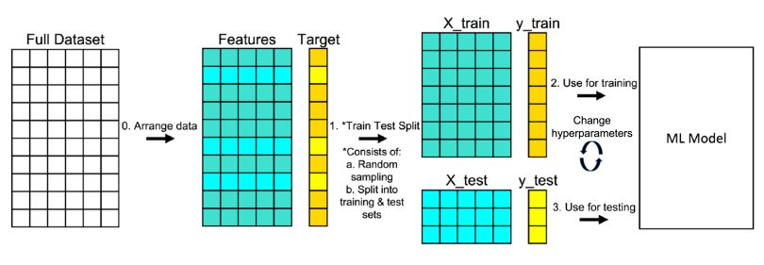
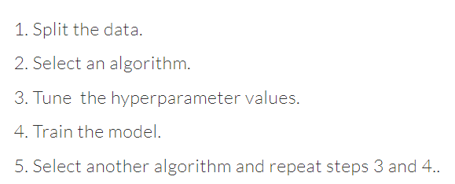
- Training data
After choosing an algorithm to train the dataset, it is necessary to optimize the parameters of the algorithms to have greater feedback and precision from them, this part is called “ Tune the Hyperparameters “
Hyperparameters are the high-level attributes set by the data science team before the model is assembled and trained. While many attributes can be learned from the training data, they cannot learn their own hyperparameters.
As an example, in my case I’m using a regression algorithm, the model can determine the regression coefficients itself by analyzing the data. However, it cannot dictate the strength of the penalty it should use to regularize an overabundance of variables. As another example, a model using the random forest technique can determine where decision trees will be split, but the number of trees to be used needs to be tuned beforehand.
This image represents the whole process that the data goes through to finally obtain a MODEL
The target variable is the feature of a dataset that you want to understand more clearly. It is the variable that the user would want to predict using the rest of the dataset.
The other features are a set of them (without the target one) that I selected after the data exploration, which help the algorithms to predict the required output.
Recap of the process

Slide 55
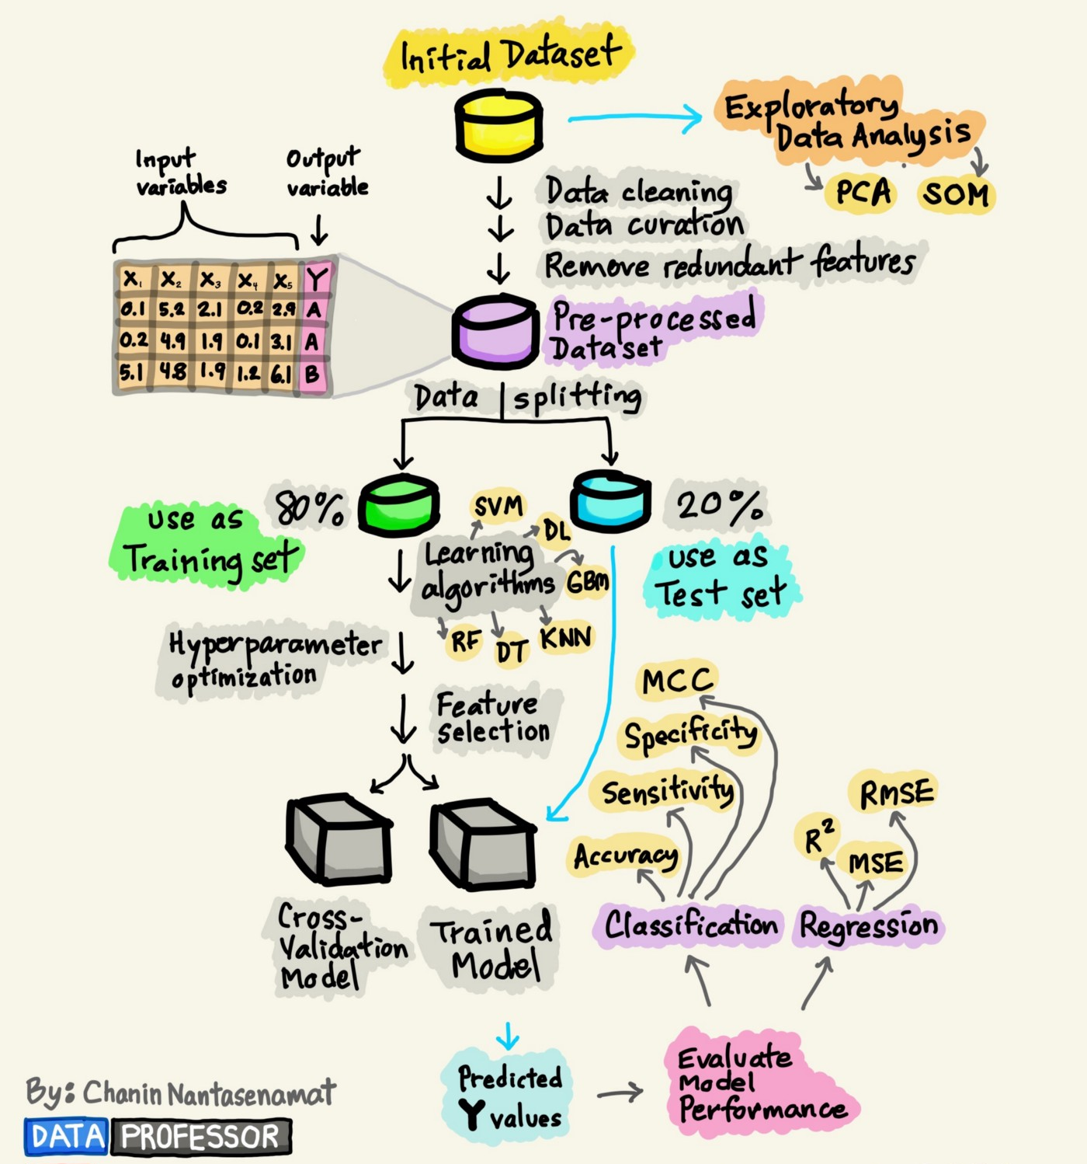
- MODEL
This photo summarizes all the steps to create a machine learning model. The best analogy is to think of the machine learning model as a “program.” The model “program” is comprised of both data and a procedure for using the data to make a prediction. The last step is to obtain and analyze the predicted results after the whole ML process.
- RESULTS
Results obtained on the basis of the analyzed problem, through specific measures it is possible to obtain various types of results
Some example / application :
- image recognition and classification;
- website optimization
- language understanding and processing
- resource monitoring
and many others …

Slide 56

CHAPTER 4 - PROCEDURE TO CHARACTERIZE performance of VNFs
SECTIONS :
4.1 – Data Preprocessing
4.2 – Apply learning algorithm to data VNFs
4.3 – Training data
4.4 - Results

Slide 57
4.1 - DATA PREPROCESSING
After Data Exploration with pandas profiling we can do this part in a easy way.
As seen many columns have “null” values, where the column types were integers (numbers), i replaced null values ​​with 0 .
Deleted the columns with all “null” values ​​and those with all identical values ​​(e.g. all 0 values)
Dropped insignificant columns (e.g. name of the experiments, id of the experiments, start and end of the experiment day) as they do not assume numerical values ​​they cannot be interpreted by the algorithms
The elements in the column identified only with TRUE and FALSE I converted them to 1 and 0 respectively. (True =1 , False=0)
Valid NGINX, HAPROXY, SQUID inputs
memory
cpu_bandwidth
requests_per_second
completed_requests
failed_requests
html_transfer_byte
mean_time_per_request
total_transfer_byte
transfer_rate_kbyte_per_second
rx_bytes / rx packets /error
tx_bytes / tx_packets /error
Valid MOSQUITTO inputs
memory
cpu_bandwidth
req_type
msg_per_sec / msg_duplicates
msg_t_mean
msg_t_std
mal_count_total
mal_time_total
mal_time_max
rx_bytes / rx packets /error/dropped
tx_bytes / tx_packets /error/dropped
mal_ft_max/mean/min / mal_test_complete

Slide 58





4.2 – Apply learning algorithm to data vnfs
CPU_BW
=
memory
req_type
rx/tx packets
rx/tx bytes
mal_time_total/min/max
msg_per_second/duplicates
the models make a prediction on the best CPU allocation within our system based on performance.
memory
req_per_second
Mean time per requests
rx/tx packets
features and selected after exploration / analysis and with the help of correlation matrices.

Slide 59

4.3 – training dataset
I used this following data split: 80% (16640 inputs) training set data, 20% (4160 inputs) test set data.
For all datasets
( https://scikit-learn.org/ )
Tools used for all the training part :
To use the regression and therefore the random forest and gradient boosting algorithms, I used the Scikit-Learn library which is able to help us implement all the machine learning techniques .
The library contains both algorithms set in a certain way (with default parameters), I partially reproduced the experiments by modifying the parameters to my liking they can be called tuned parameters (obtaining similar results) . Thanks to it I was able to build the models.
n_estimators : default =100 / tuned = 50-200 <- used (Gradient Boost : The number of boosting stages to perform. Gradient boosting is fairly robust to over-fitting so a large number usually results in better performance --Rand Forest : The number of trees in the forest.)
learning rate : default = 0.1 / tuned = 0.01 – 0.3 <- used ( Gradient Boost only : One effective way to slow down learning in the gradient boosting model is to use a learning rate, also called shrinkage)
The rest are the default parameters for both algorithms :
RandomForest scikit-learn : https://scikit-learn.org/stable/modules/generated/sklearn.ensemble.RandomForestRegressor.html
Gradient Boosting scikit-learn : https://scikit-learn.org/stable/modules/generated/sklearn.ensemble.GradientBoostingClassifier.html

Slide 60
Models studies - important definitions for algorithms
In the next slides we will often find the following terms related to the results that the algorithms will produce.
I will take a closer look at the popular metrics for regression models and how to calculate them for your predictive modeling project :
Mean Squared Error (MSE) : measures how close a regression line is to a set of data points. It is a risk function corresponding to the expected value of the squared error loss. Mean square error is calculated by taking the average, specifically the mean, of errors squared from data as it relates to a function. (https://en.wikipedia.org/wiki/Mean_squared_error)
Mean Absolute Error (MAE) : is a measure of errors between paired observations expressing the same phenomenon. Examples of Y versus X include comparisons of predicted versus observed, subsequent time versus initial time, and one technique of measurement versus an alternative technique of measurement. like RMSE, the units of the error score match the units of the target value that is being predicted. Unlike the RMSE, the changes in MAE are linear and therefore intuitive. (https://en.wikipedia.org/wiki/Mean_absolute_error)
Root Mean Square Error (RMSE) : is a standard way to measure the error of a model in predicting quantitative data, is a good estimator for the standard deviation of the distribution of our errors. is always non-negative, and a value of 0 (almost never achieved in practice) would indicate a perfect fit to the data. In general, a lower RMSE is better than a higher one. The RMSE gives a relatively high weight to large errors. This means the RMSE is most useful when large errors are particularly undesirable. (https://en.wikipedia.org/wiki/Root-mean-square_deviation)
R2 : tells us how well our model is fitted to the data by comparing it to the average line of the dependent variable. If the score is closer to 1, then it indicates that our model performs well versus if the score is farther from 1, then it indicates that our model does not perform so well.
(https://en.wikipedia.org/wiki/Coefficient_of_determination)

Slide 61
4.4 - NGINX – REGRESSION results ( RANDOM FOREST – BOOSTING )
RANDOM FOREST
R2 = 0.8174463900128831
MSE = 0.015719862499999997
MAE = 0.05960625000000015
RMSE = 0.2226632865518287
GRADIENT BOOSTING
R2 = 0.8613539481926695
MSE = 0.011938941501802794
MAE = 0.058427320089897004
RMSE = 0.1892654634447811
these are the results that I observed by applying the measures described in the previous slide to the data.
NOTE : from the results it seems to be the Gradient Boost, the most accurate and best (albeit slightly) algorithm. In fact, we can see how the R2 is higher than the Random Forest and the corresponding MSE, MAE and RMSE all have lower values ​​than the Random Forest .
It is more useful and intuitive to make observations with the graphs about the results obtained, in the following slides we will see them in detail .

Slide 62

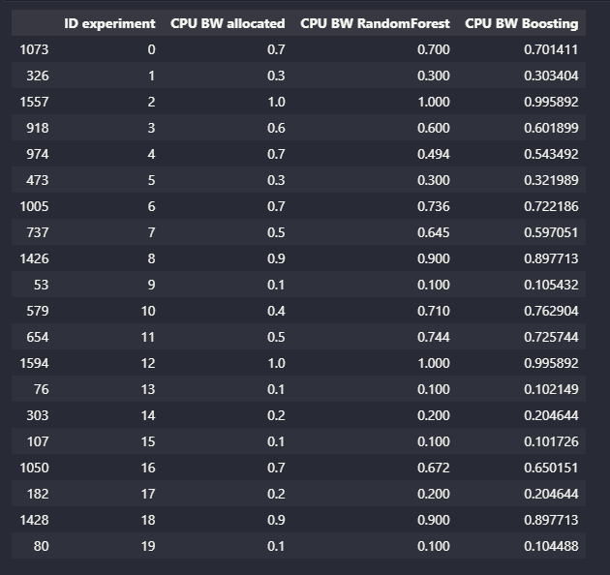
4.4 - NGINX – REGRESSION results ( RANDOM FOREST – BOOSTING ) (2)
I randomly chose 20 experiments from the datasets (you can see from the first column on the left which contains random numbers it means that I don’t take close experiment but in a random order)
ID experiment : added this column to be clearer when talking about a specific experiment, just to simplify the visualization (also in the graph)
CPU BW allocated : column that tells us the value of the allocated CPU (CPU bandwidth) that the dataset contains for the experiment in question
CPU BW Random Forest : column that tells us the prediction of the allocable CPU (CPU bandwidth) obtained with the application of the Random Forest algorithm for the experiment in question
CPU BW Boosting : column that tells us the prediction of the allocable CPU (CPU bandwidth) obtained with the application of the Gradient Boosting algorithm for the experiment in question
To get an example/idea of ​​how the two algorithms work (and to have a comparison of the two) I generated this table:

Slide 63
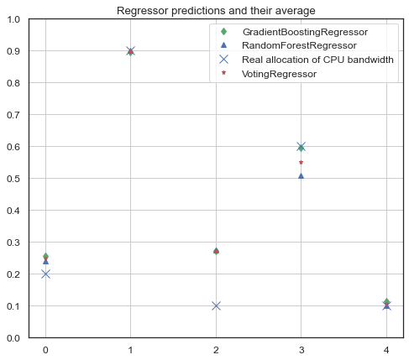
4.4 - NGINX – REGRESSION results ( RANDOM FOREST – BOOSTING ) (3)
The explanations of how the algorithms work are explained on slides 45 and 46. But in short it is important to understand this: the algorithms read the entire dataset and in this case try to understand the best CPU that can be allocated for the experiments through their calculations .
in green are the predictions relating to the Gradient Boost,
in blue (triangle) there are the predictions related to the Random Forest,
in red instead there is a prediction that indicates the average of the two previous algorithms applied (it could be the optimal prediction),
the X indicate the true values ​​of CPU bw that each experiment used.
How do you read the chart ?
Example : for the experiment 3 the cpu bw used is 60% (0.6) , the prediction made by the boosting algorithm is very similar to the real allocation of CPU, while the random forest advises us to allocate a maximum of 50% of cpu for the same experiment.
in this case we could rely more on the Gradient Boosting regressor since it has the highest R2 values ​​and lower errors (compared to Random Forest), but we could also rely on the Voting Regressor (in red) which is the average of the two algorithms.
it can be seen that the predictions of both in many cases are similar / equal to the values ​​actually used for the cpu. While when they do not match the Gradient Boost is closer to real use.
CPU
BANDWIDTH
RANDOM EXPERIMENTS IDs

Slide 64
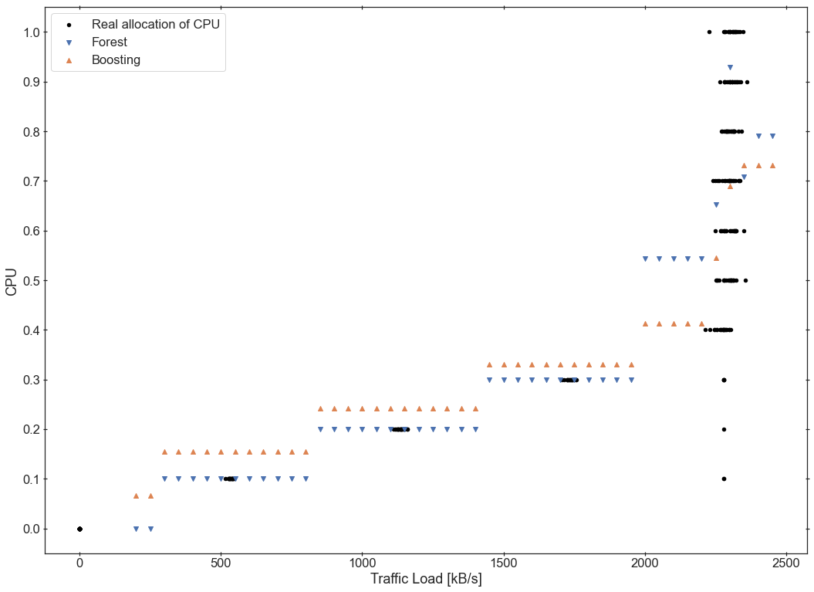
4.4 - NGINX – REGRESSION results ( RANDOM FOREST – BOOSTING ) (4)
The type of graph below is similar to the previous one, but in this case the experiments are divided according to their troughpout i.e. the amount of data transferred during a specific period of time
in orange are the predictions relating to the Gradient Boost,
in blue there are the predictions related to the Random Forest,
the • indicate the true values ​​of CPU bw that each experiment used.
How do you read the chart ?
Example : now in the we have the Traffic Load expressed in Kbytes per second. X-axis
In the range from 1100 to 1200 Bytes per second, 20% of the CPU bandwith is allocated in the experiments. Random forest confirms the prediction while gradient boosting recommends allocating more cpu.
While in the range from 2200 to 2400 there are conflicts, the two algorithms certainly recommend allocating more than 50% of the CPU, the gradient boost is the only one that recommends in some cases to allocate even 90%, while in general for the experiments in that range the CPU is allocated ranging from 40 to 100% .
in general the algorithms follow the following logic: the more the traffic grows the more CPUs need to be allocated .

Slide 65
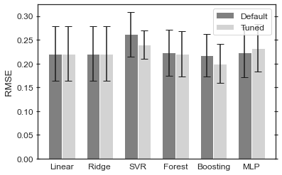
4.4 - NGINX – REGRESSION results ( RANDOM FOREST – BOOSTING ) (5)
In this slide we will analyze in more detail the RMSE error by comparing it, because it is one of the most used measures in this type of studies
Why is Root Mean Square Error (RMSE) Important?
In Machine Learning, it is extremely helpful to have a single number to judge a model’s performance, whether it be during training, cross-validation, or monitoring after deployment. Root Mean Square Error is one of the most widely used measures for this. It is a proper scoring rule that is intuitive to understand and compatible with some of the most common statistical assumptions.
as explained in the slide 51 In all experiments we have two types of hyperparameters on which the results are based , the Default and the Tuned hyperp. that in my opinion are optimal in this case I modified this parameter : • n_estimator : 50 – 200 default is 100
• learning_rate : 0.01 - 0.3 default is 0.1
I also generated RMSE values ​​of other algorithms (which I have not deepened) but I did it only to have a comparison. And from what you can see Random Forest and Boosting (above all) have the lowest RMSE

Slide 66
4.4 - HAPROXY – REGRESSION results ( RANDOM FOREST – BOOSTING )
RANDOM FOREST
R2 = 0.9430982723755491
MSE = 0.0048998611111111135
MAE = 0.028479166666666778
RMSE = 0.13951980830145308
GRADIENT BOOSTING
R2 = 0.9512843263328108
MSE = 0.00419495233042573
MAE = 0.02755702197235057
RMSE = 0.14101259467741026
these are the results that I observed by applying the measures described in the previous slide to the data.
NOTE : from the results it seems to be the Gradient Boost, the most accurate and best (albeit slightly) algorithm. In fact, we can see how the R2 is higher than the Random Forest and the corresponding MSE, MAE have lower values ​​than the Random Forest which the RMSE is better in the Random Forest case.
It is more useful and intuitive to make observations with the graphs about the results obtained, in the following slides we will see them in detail .

Slide 67
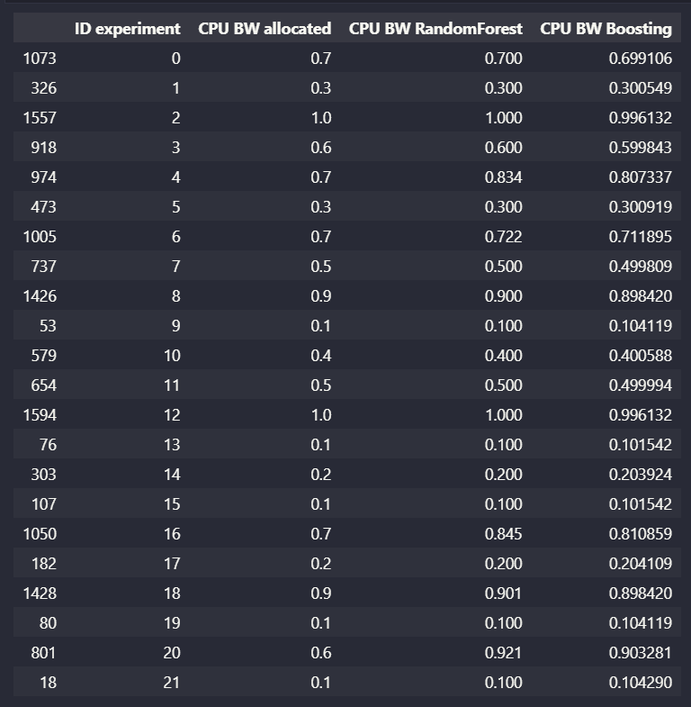
4.4 - HAPROXY – REGRESSION results ( RANDOM FOREST – BOOSTING )
To get an example/idea of ​​how the two algorithms work (and to have a comparison of the two) I generated this table:
I randomly chose 20 experiments from the datasets (you can see from the first column on the left which contains random numbers it means that I don’t take close experiment but in a random order)
ID experiment : added this column to be clearer when talking about a specific experiment, just to simplify the visualization (also in the graph)
CPU BW allocated : column that tells us the value of the allocated CPU (CPU bandwidth) that the dataset contains for the experiment in question
CPU BW Random Forest : column that tells us the prediction of the allocable CPU (CPU bandwidth) obtained with the application of the Random Forest algorithm for the experiment in question
CPU BW Boosting : column that tells us the prediction of the allocable CPU (CPU bandwidth) obtained with the application of the Gradient Boosting algorithm for the experiment in question

Slide 68
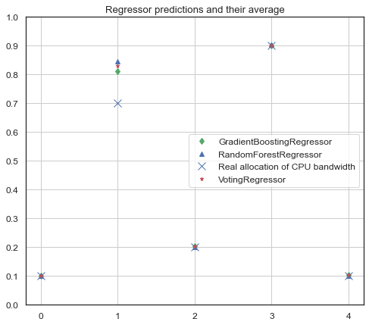
4.4 - HAPROXY – REGRESSION results ( RANDOM FOREST – BOOSTING )
The explanations of how the algorithms work are explained on slides 45 and 46. But in short it is important to understand this: the algorithms read the entire dataset and in this case try to understand the best CPU that can be allocated for the experiments through their calculations .
in green are the predictions relating to the Gradient Boost,
in blue (triangle) there are the predictions related to the Random Forest,
in red instead there is a prediction that indicates the average of the two previous algorithms applied (it could be the optimal prediction),
the X indicate the true values ​​of CPU bw that each experiment used.
How do you read the chart ?
Example : for the experiment 1 the cpu bw used is 70% (0.7) , the prediction made by the algorithms are not very similar , both predicted 80 – 85 % of cpu bw.
in this case both of R2 values are very very similar and in fact the predictions are similar in general also with the real CPU bw .
it can be seen that the predictions of both in many cases are similar / equal to the values ​​actually used for the cpu. While when they do not match the Gradient Boost is closer to real use.
CPU
BANDWIDTH
RANDOM EXPERIMENTS IDs

Slide 69
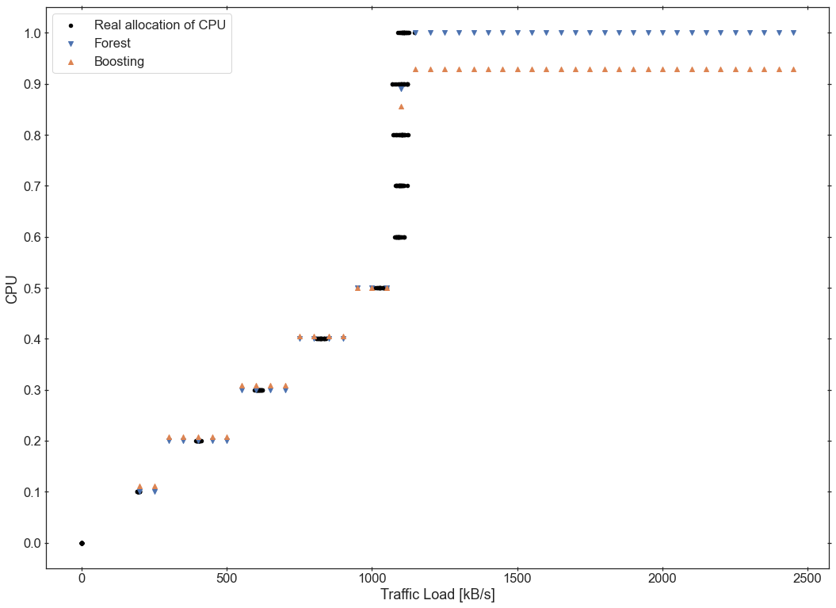
4.4 - HAPROXY – REGRESSION results ( RANDOM FOREST – BOOSTING )
The type of graph below is similar to the previous one, but in this case the experiments are divided according to their troughpout i.e. the amount of data transferred during a specific period of time
in orange are the predictions relating to the Gradient Boost,
in blue there are the predictions related to the Random Forest,
the • indicate the true values ​​of CPU bw that each experiment used.
How do you read the chart ?
Example : now in the we have the Traffic Load expressed in Kbytes per second. X-axis
A lot of data is concentrated between 1000 and 1200 Kb/s, the algorithms agree on the use of the cpu up to 1000 Kb/s you can use the CPU up to 50%, as soon as the threshold of 1000 is passed it is recommended> of 80% CPU bw.
In general the algorithms follow the following logic: the more the traffic grows the more CPUs need to be allocated .

Slide 70
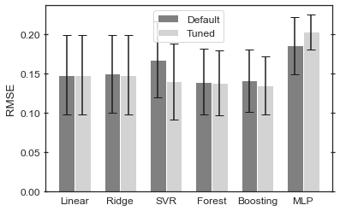
4.4 - HAPROXY – REGRESSION results ( RANDOM FOREST – BOOSTING )
In this slide we will analyze in more detail the RMSE error by comparing it, because it is one of the most used measures in this type of studies
Why is Root Mean Square Error (RMSE) Important?
In Machine Learning, it is extremely helpful to have a single number to judge a model’s performance, whether it be during training, cross-validation, or monitoring after deployment. Root Mean Square Error is one of the most widely used measures for this. It is a proper scoring rule that is intuitive to understand and compatible with some of the most common statistical assumptions.
as explained in the slide 51 In all experiments we have two types of hyperparameters on which the results are based , the Default and the Tuned hyperp. that in my opinion are optimal in this case I modified this parameter : • n_estimator : 50 – 200 default is 100
• learning_rate : 0.01 - 0.3 default is 0.1
I also generated RMSE values ​​of other algorithms (which I have not deepened) but I did it only to have a comparison. And from what you can see Random Forest and Boosting (above all) have the lowest RMSE

Slide 71
4.4 - SQUID – REGRESSION results ( RANDOM FOREST – BOOSTING )
RANDOM FOREST
R2 = 0.9491608934695432
MSE = 0.004377803125000002
MAE = 0.02789062500650069
RMSE = 0.12469996551840354
GRADIENT BOOSTING
R2 = 0.9612927205562168
MSE = 0.004457803125000002
MAE = 0.02534062500000047
RMSE = 0.12524418144472926
these are the results that I observed by applying the measures described in the previous slide to the data.
NOTE : The values of R2 are very very high from the results it seems to be the Gradient Boost, the most accurate and best (albeit slightly) algorithm. In fact, we can see how the R2 is higher than the Random Forest and the corresponding MSE, RMSE have lower values ​​than the Random Forest which the MSE is better in the Random Forest case.
It is more useful and intuitive to make observations with the graphs about the results obtained, in the following slides we will see them in detail .

Slide 72
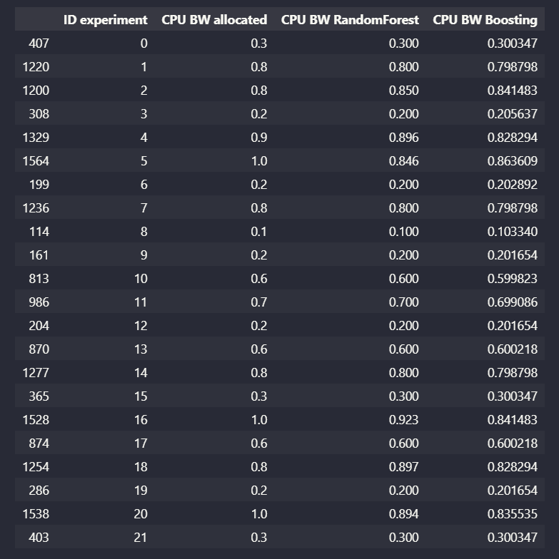
4.4 - SQUID – REGRESSION results ( RANDOM FOREST – BOOSTING )
To get an example/idea of ​​how the two algorithms work (and to have a comparison of the two) I generated this table:
I randomly chose 20 experiments from the datasets (you can see from the first column on the left which contains random numbers it means that I don’t take close experiment but in a random order)
ID experiment : added this column to be clearer when talking about a specific experiment, just to simplify the visualization (also in the graph)
CPU BW allocated : column that tells us the value of the allocated CPU (CPU bandwidth) that the dataset contains for the experiment in question
CPU BW Random Forest : column that tells us the prediction of the allocable CPU (CPU bandwidth) obtained with the application of the Random Forest algorithm for the experiment in question
CPU BW Boosting : column that tells us the prediction of the allocable CPU (CPU bandwidth) obtained with the application of the Gradient Boosting algorithm for the experiment in question

Slide 73

4.4 - SQUID – REGRESSION results ( RANDOM FOREST – BOOSTING )
The explanations of how the algorithms work are explained on slides 45 and 46. But in short it is important to understand this: the algorithms read the entire dataset and in this case try to understand the best CPU that can be allocated for the experiments through their calculations .
in green are the predictions relating to the Gradient Boost,
in blue (triangle) there are the predictions related to the Random Forest,
in red instead there is a prediction that indicates the average of the two previous algorithms applied (it could be the optimal prediction),
the X indicate the true values ​​of CPU bw that each experiment used.
How do you read the chart ?
Example : for the experiment 4 the cpu bw used is 90% (0.9) , the prediction made by the Random Forest algorithm are the same , instead the Gradient Boosting predicted 85% of cpu bw.
in this case both of R2 values are very similar and in fact in a lot of cases the predictions are similar .
it can be seen that the predictions of both in many cases are similar / equal to the values ​​actually used for the cpu. While when they do not match the Gradient Boost is closer to real use.
CPU
BANDWIDTH
RANDOM EXPERIMENTS IDs

Slide 74

4.4 - SQUID – REGRESSION results ( RANDOM FOREST – BOOSTING )
The type of graph below is similar to the previous one, but in this case the experiments are divided according to their troughpout i.e. the amount of data transferred during a specific period of time
in orange are the predictions relating to the Gradient Boost,
in blue there are the predictions related to the Random Forest,
the • indicate the true values ​​of CPU bw that each experiment used.
How do you read the chart ?
Example : now in the we have the Traffic Load expressed in Kbytes per second. X-axis
From 0 to 2000 kB per second, the algorithms predict the same as what has been allocated, then from 2000 kB/s upwards they recommend to always allocate at least 80% of the CPU
In general the algorithms follow the following logic: the more the traffic grows the more CPUs need to be allocated .

Slide 75

4.4 - SQUID – REGRESSION results ( RANDOM FOREST – BOOSTING )
In this slide we will analyze in more detail the RMSE error by comparing it, because it is one of the most used measures in this type of studies
Why is Root Mean Square Error (RMSE) Important?
In Machine Learning, it is extremely helpful to have a single number to judge a model’s performance, whether it be during training, cross-validation, or monitoring after deployment. Root Mean Square Error is one of the most widely used measures for this. It is a proper scoring rule that is intuitive to understand and compatible with some of the most common statistical assumptions.
as explained in the slide 51 In all experiments we have two types of hyperparameters on which the results are based , the Default and the Tuned hyperp. that in my opinion are optimal in this case I modified this parameter : • n_estimator : 50 – 200 default is 100
• learning_rate : 0.01 - 0.3 default is 0.1
I also generated RMSE values ​​of other algorithms (which I have not deepened) but I did it only to have a comparison. And from what you can see in this case (unlike the previous ones) both the algorithms are those with a higher RMSE value than the others

Slide 76
4.4 - MOSQUITTO – REGRESSION results ( RANDOM FOREST – BOOSTING )
RANDOM FOREST
R2 = 0.006841501696575936
MSE = 0.08552180937500001
MAE = 0.245834375
RMSE = 0.29244112121074906
GRADIENT BOOSTING
R2 = 0.04041659621740945
MSE = 0.08263062650915991
MAE = 0.2475572727471677
RMSE = 0.2874554339530911
these are the results that I observed by applying the measures described in the previous slide to the data.
In this case the R2 measures is low in both the cases … this can cause big errors of evaluation, in fact also MSE, RMSE and MAE are very high, even compared to the 3 previous studies ..

Slide 77

4.4 - MOSQUITTO – REGRESSION results ( RANDOM FOREST – BOOSTING ) (2)
As you can see, almost prediction of the algorithms not corresponds with the value allocated for each CPU experiment (only some correspond, the percentage is very low), in fact, as you can see in the previous slide, the R2 is really very low and the errors are very big.

Slide 78


CHAPTER 5 - CONCLUSIONS
I chose the results of the Gradient Boosting algorithm as a reference because as we have seen it performs the data better (it has the highest R2 value and lower errors)
Traffic Load [kB/s] | CPU Bandwidth predicted
0-500 | 0-10%
500-1000 | 20-30%
1000-1250 | 30-40%
1250-1650 | 40-50%
1650-2000 | 50-70%
2000-2250 | 70-90%
2250-2500 | 70-80%
Traffic Load [kB/s] | CPU bandwidth predicted
0-750 | 0-15%
750-1400 | 20-25%
1400-1900 | 30%
2000-2200 | 30-40%
2200-2500 | 50-70%
Traffic Load [kB/s] | CPU bandwidth predicted
0-1000 | 0-60%
1000-1250 | 60-90%
1250-2500 | 100%
This is the VNF that has the best performance
Because it allocates less CPU with the same Traffic Load

Slide 79
CHAPTER 6 - STEPS/Plans for the next session
(to be defined week by week)
Add the studies of Extreme Boosting algorithm
Improve MOSQUITTO results (change Hyperparameters )
Improve the slides from time to time in a better way

Slide 80
CHAPTER 7 – FUTURE WORK
Application to Automated-Assurance micro-services
Application to 5G slices

Slide 81
Thank you

